Slide 1

Mid-Project
By Manel Ait Amer

Slide 2
Introduction:
This data set represents thousands of loans made through the Lending Club platform, which is a platform that allows individuals to lend to other individuals.
This could be for various purposes such as debt consolidation, home improvement, education, or small business funding.
They provide an alternative to traditional banking channels by leveraging technology to streamline the lending process and offer potentially better rates for both borrowers and investors.

Slide 3
Our initial data frame with 10,000 observations on the following 55 variables.
num_open_cc_accounts
sub_grade
current_installment_accounts
num_cc_carrying_balance
paid_late_fees
accounts_opened_24m
inquiries_last_12m
num_active_debit_accounts
months_since_last_credit_inquiry
num_mort_accounts
loan_purpose
delinq_2y
emp_length
num_historical_failed_to_pay
tax_liens
grade
loan_status
num_collections_last_12m
public_record_bankrupt
issue_month
verification_income_joint
verified_income
homeownership
application_type
current_accounts_delinq
term
num_accounts_30d_past_due
initial_listing_status
total_credit_utilized
total_credit_limit
paid_total
paid_interest
paid_principal
balance
emp_title
debt_to_income
installment
annual_income
total_debit_limit
debt_to_income_joint
total_collection_amount_ever
loan_amount
annual_income_joint
account_never_delinq_percent
months_since_90d_late
months_since_last_delinq
total_credit_lines
interest_rate
num_total_cc_accounts
earliest_credit_line
state
open_credit_lines
num_satisfactory_accounts
disbursement_method
num_accounts_120d_past_due

Slide 4
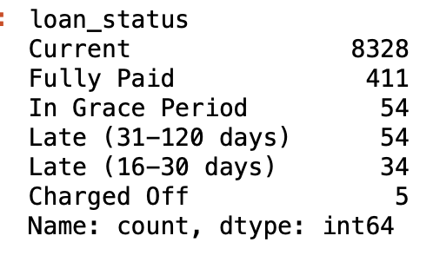
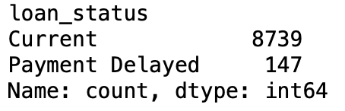
Data Cleaning:
Dropping Nan values.
Checking duplicates and spaces.
Replacing some information to make the data more clear (will help for visualization) for ex:
→
Copy the data under ‘loan_data’.
Convert ‘verified_income’ and ‘term’ to ‘bool’.

Slide 5
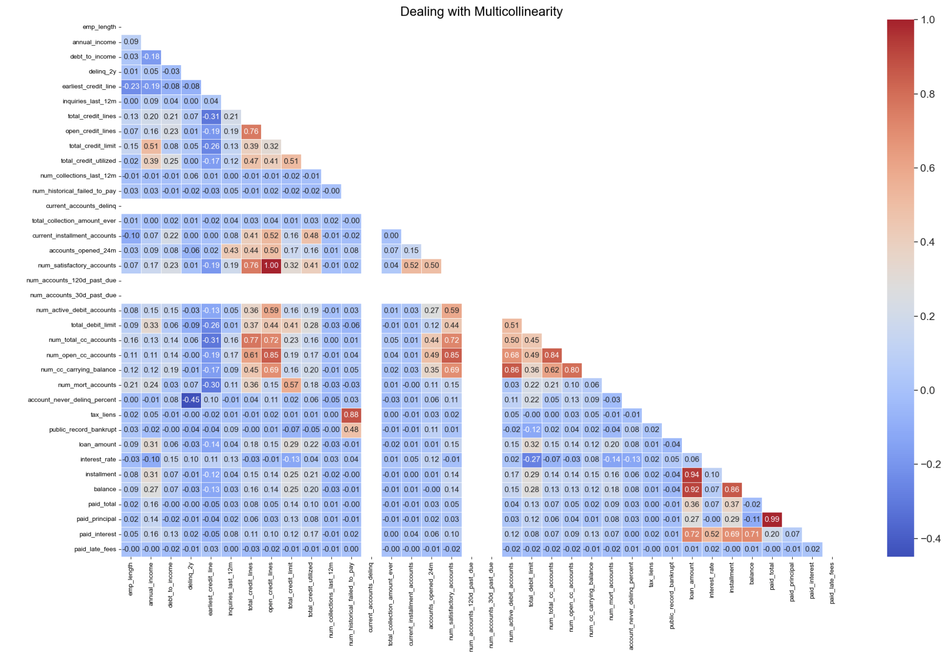
Correlation Matrix-Heatmap Plot:
The heatmap doesn’t give any information from the first tentative.
I will start dropping first the columns where I have no info (white) and the correlated columns.
The same process is repeated until, we don’t have an important correlation in our heatmap.

Slide 6
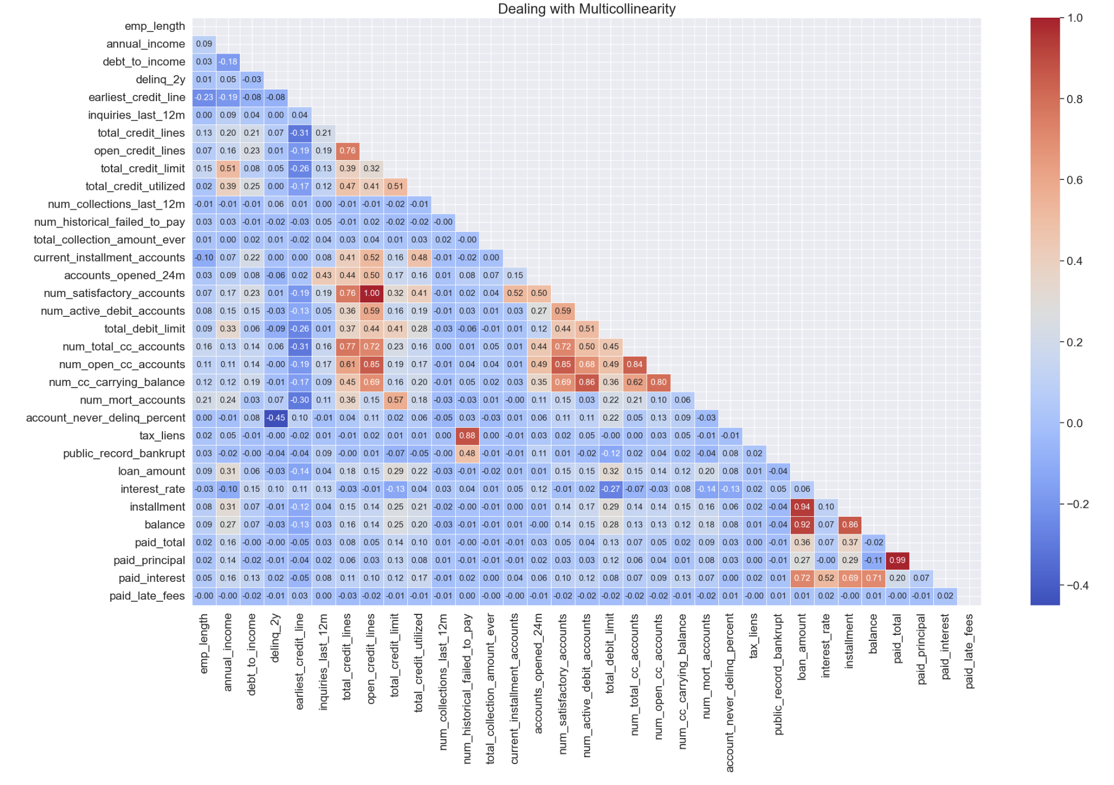

Slide 7
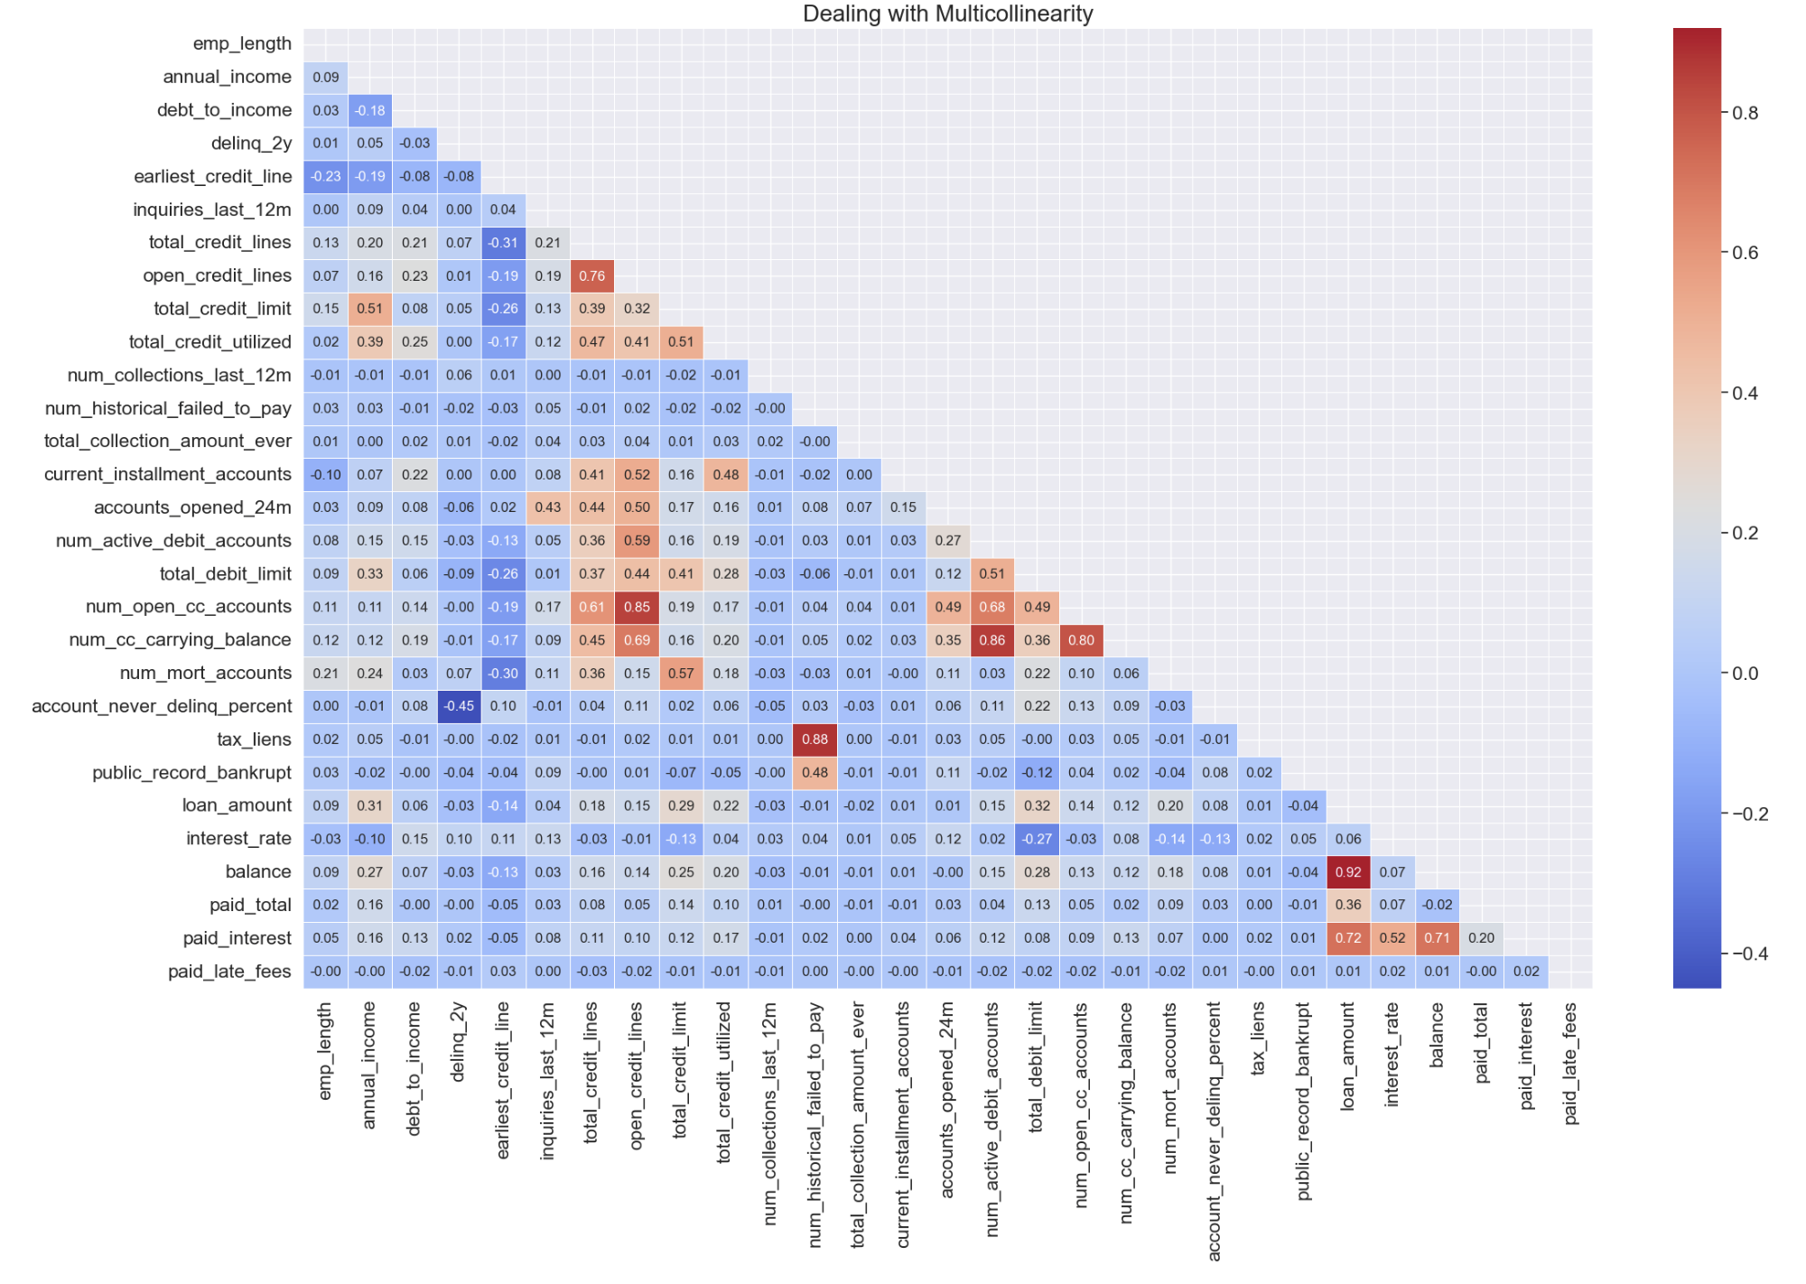

Slide 8
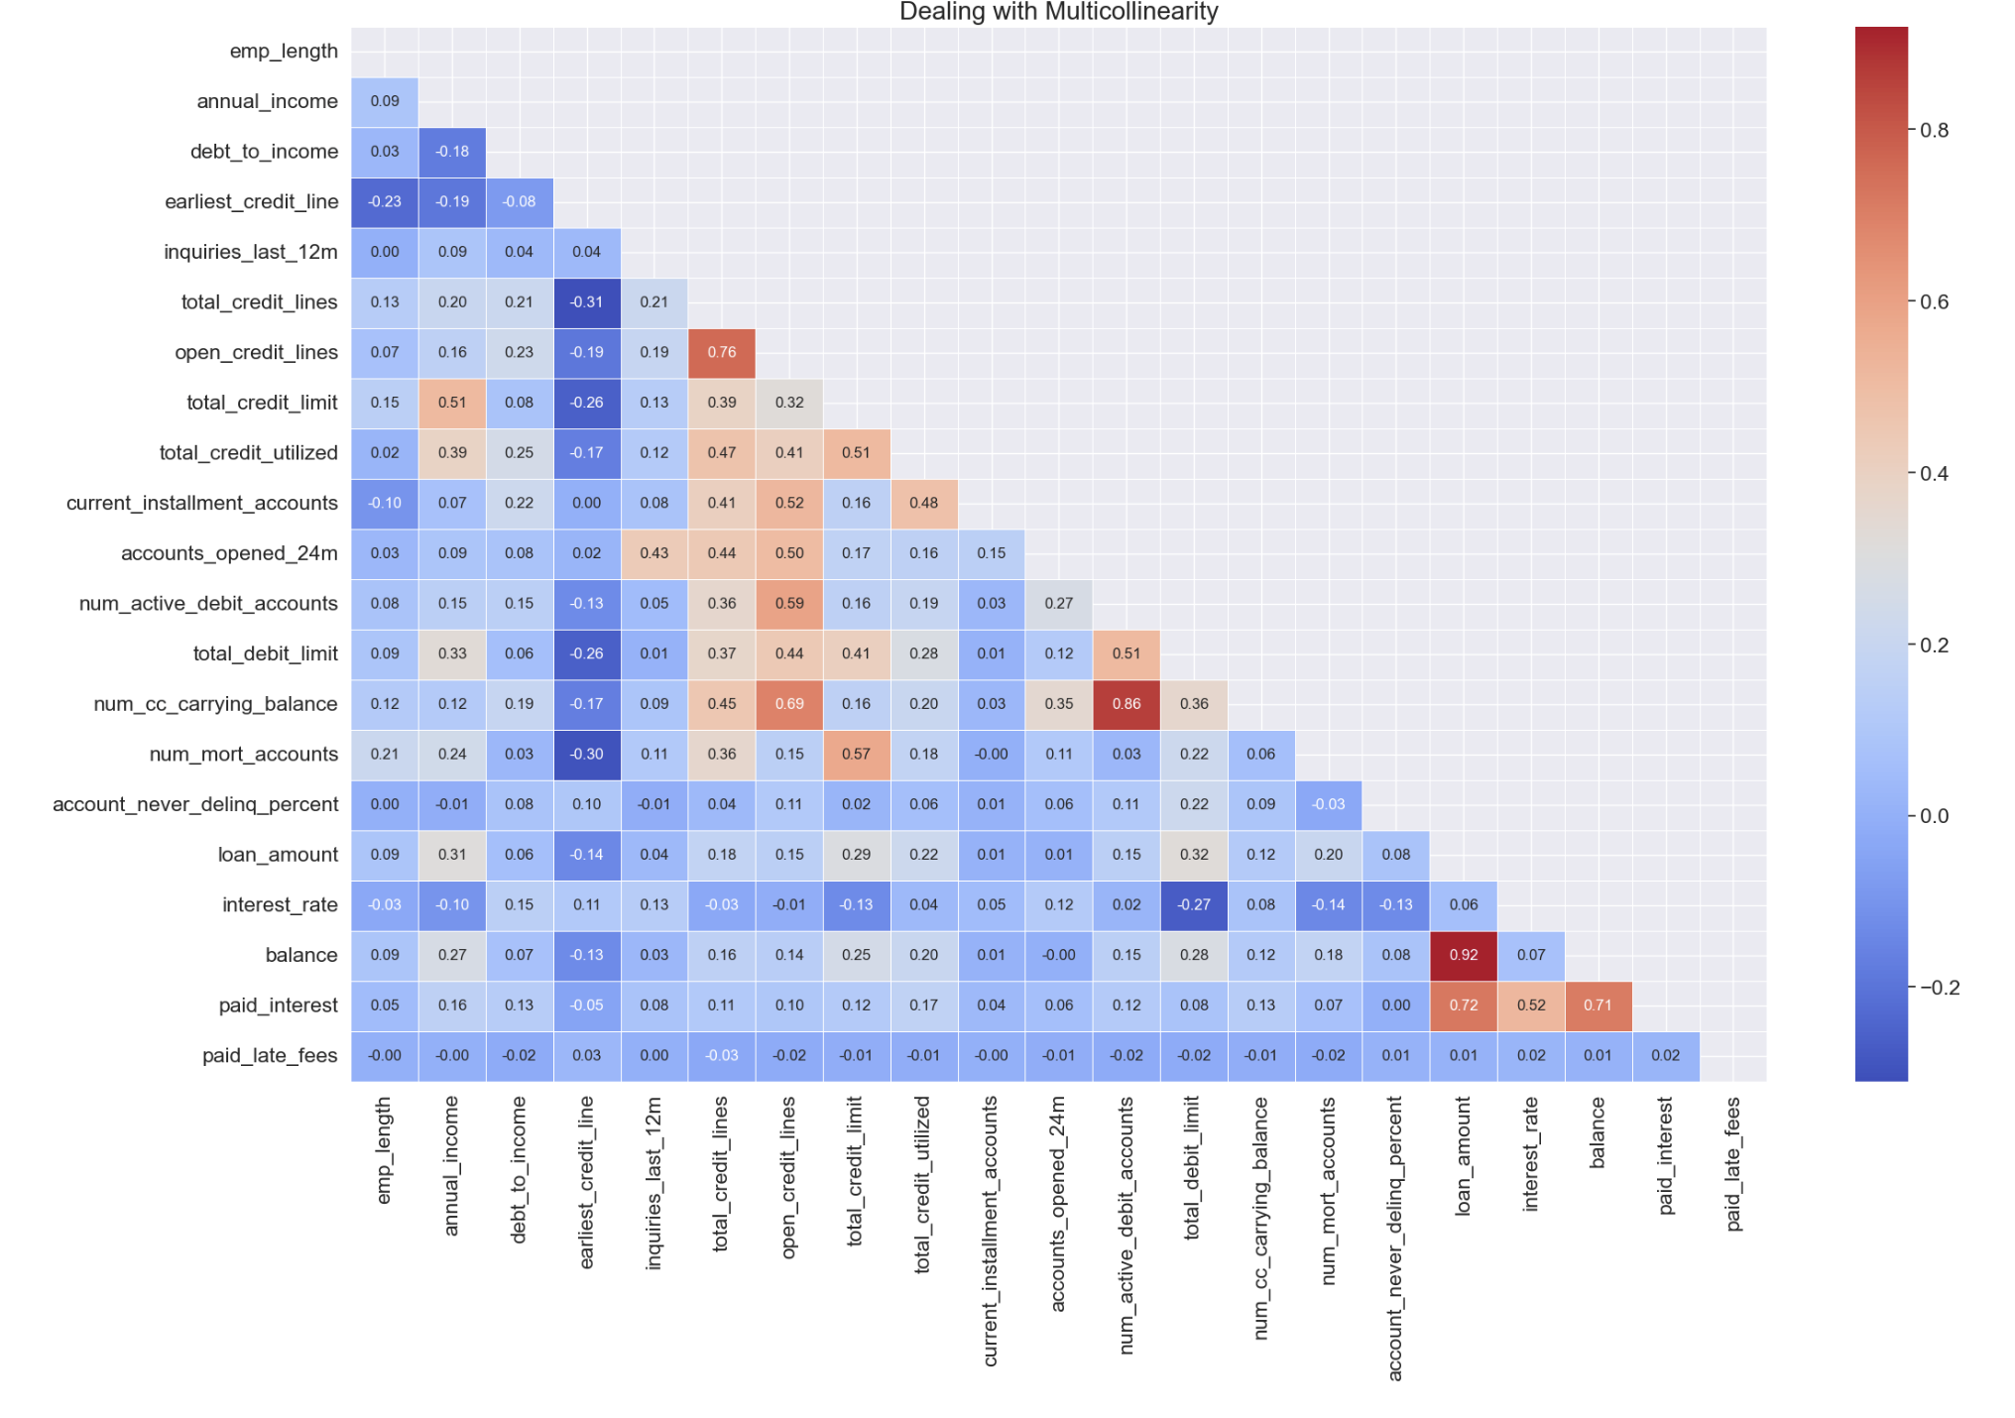

Slide 9
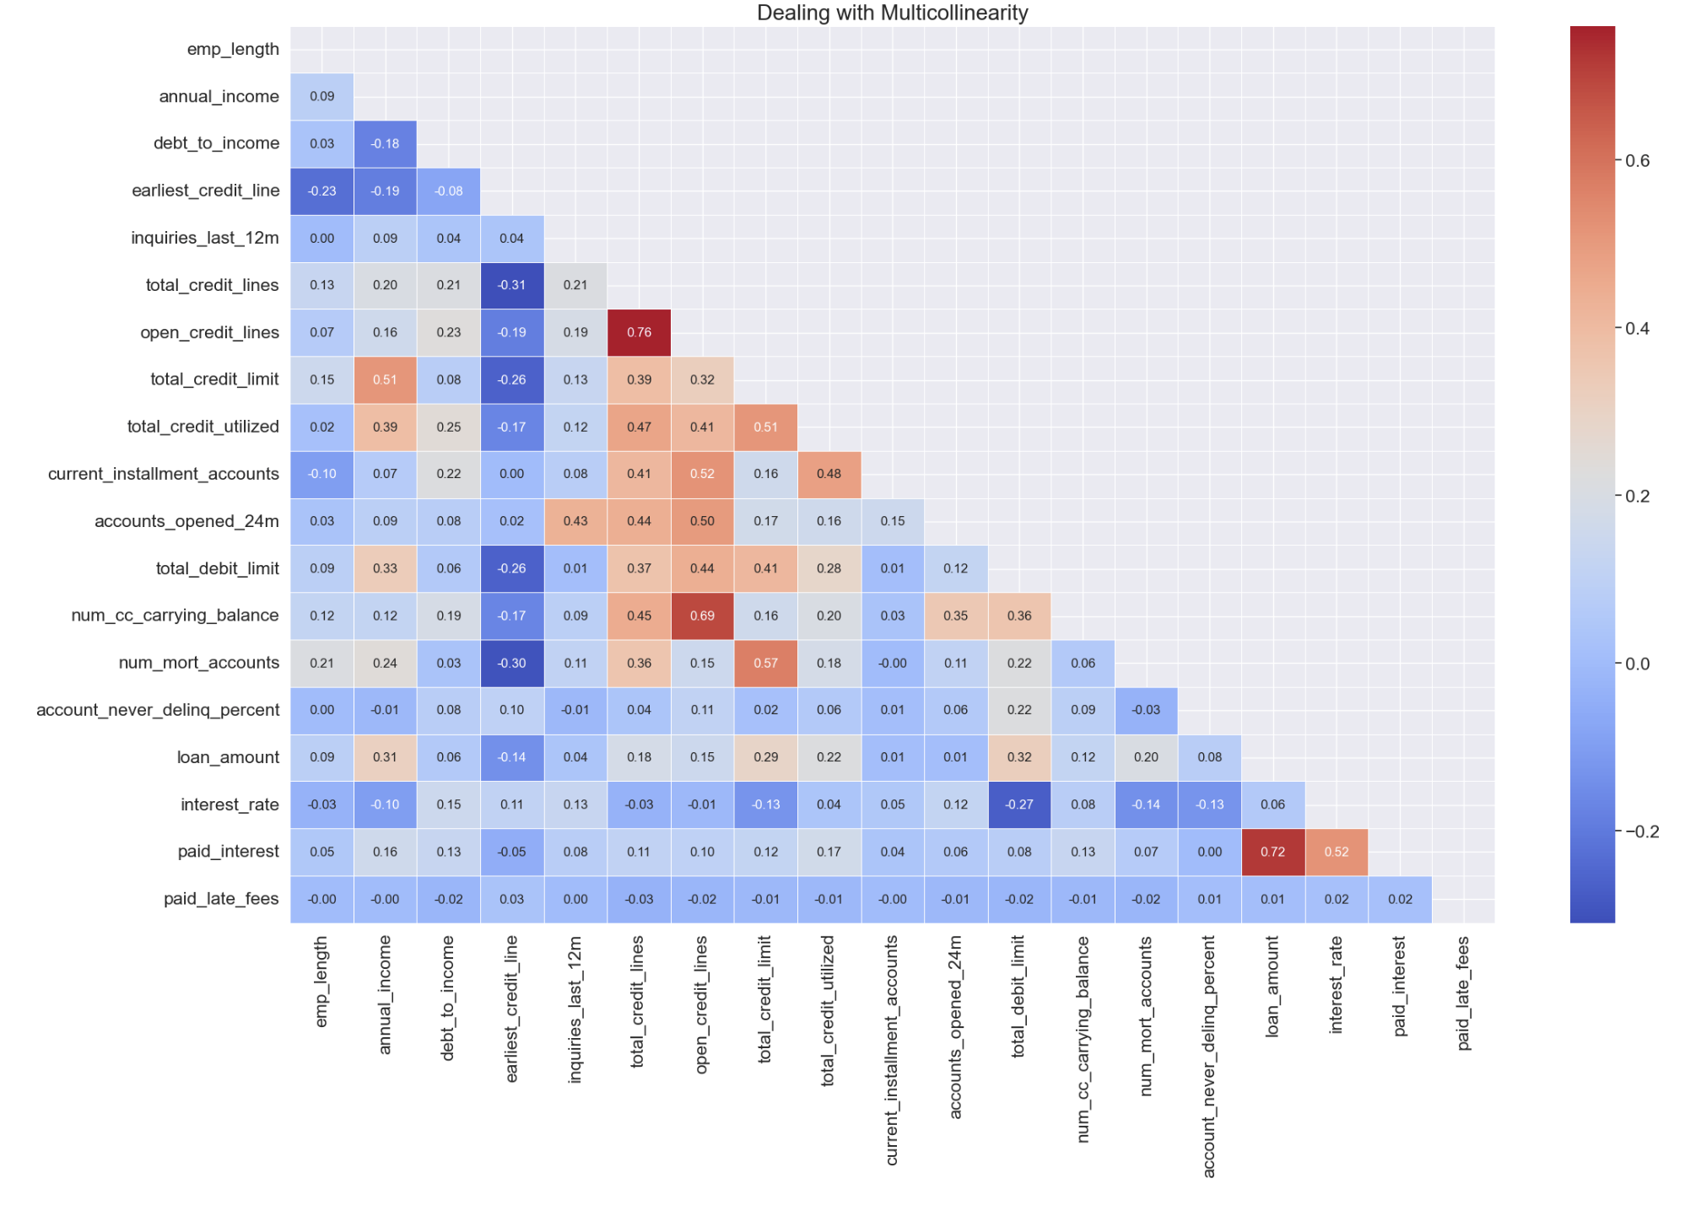
Final correlation Matrix-heatmap:
The shape of our data now is :
8886 rows and 29 columns.

Slide 10
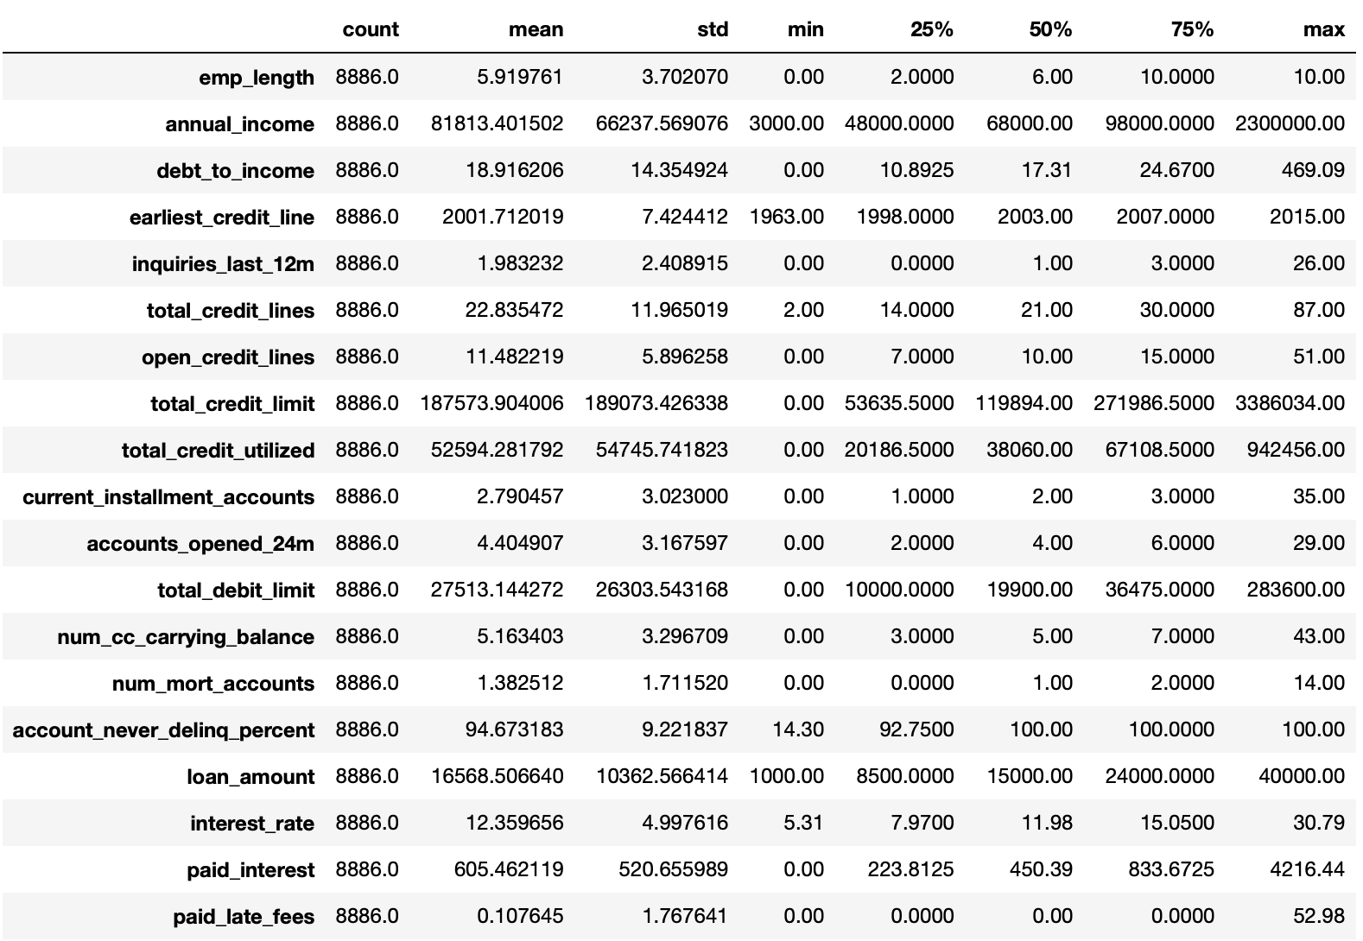
Description:

Slide 11
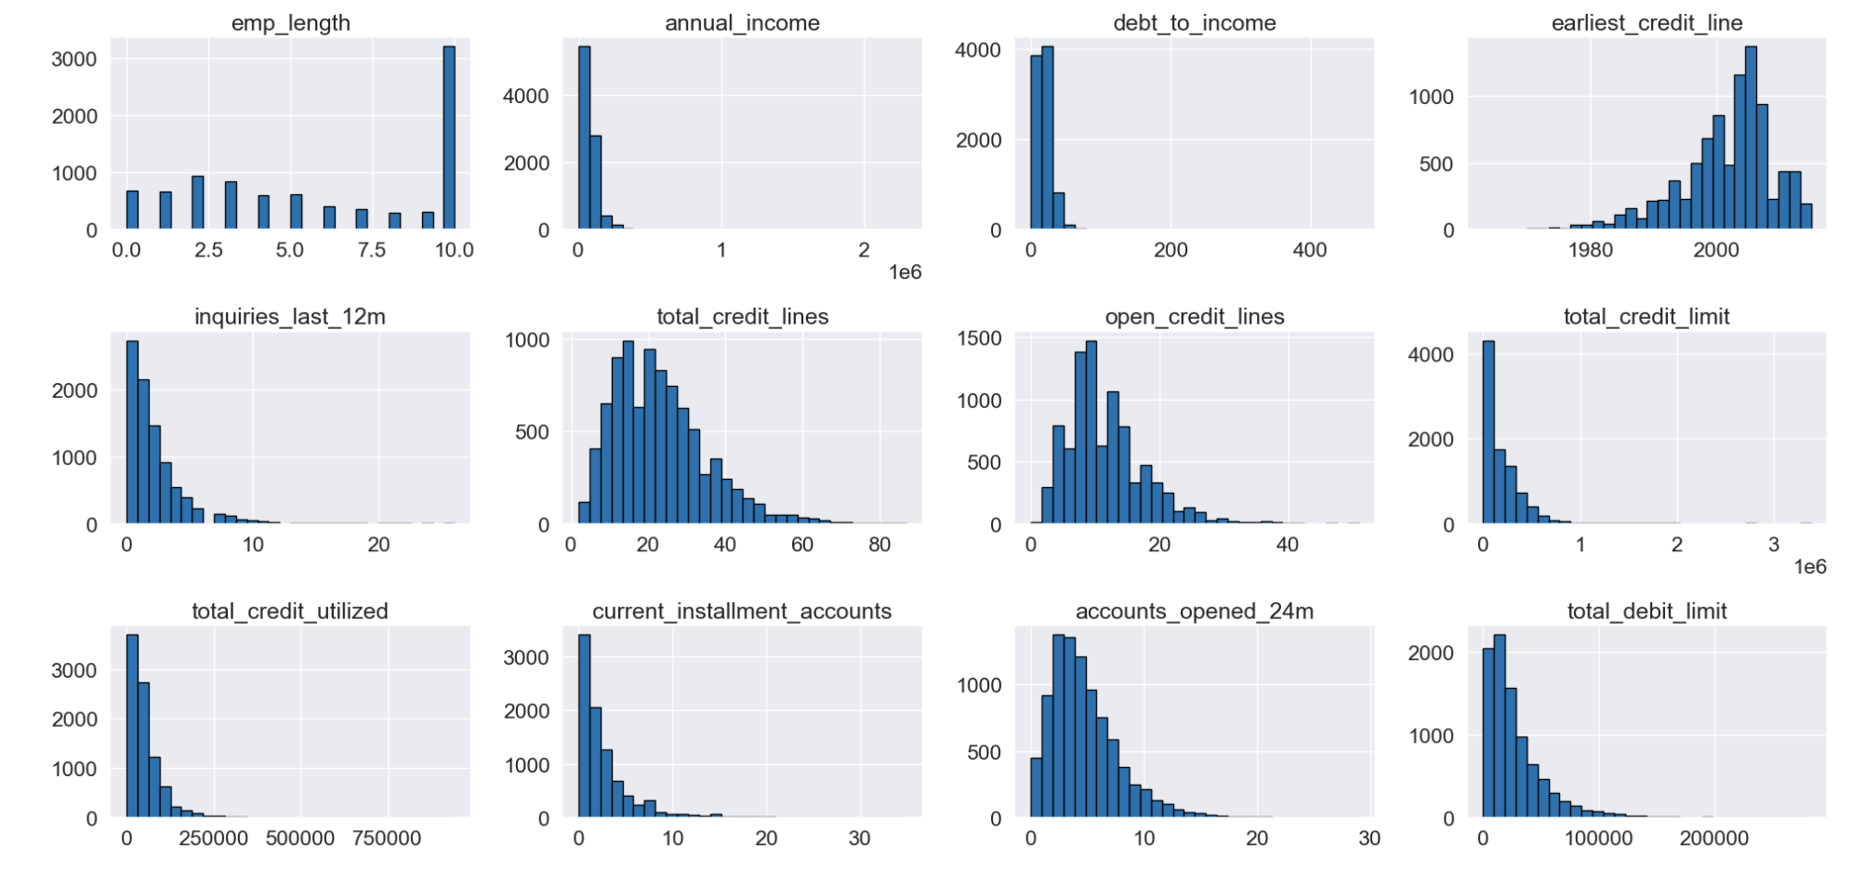
Data visualization:
Histogram:

Slide 12
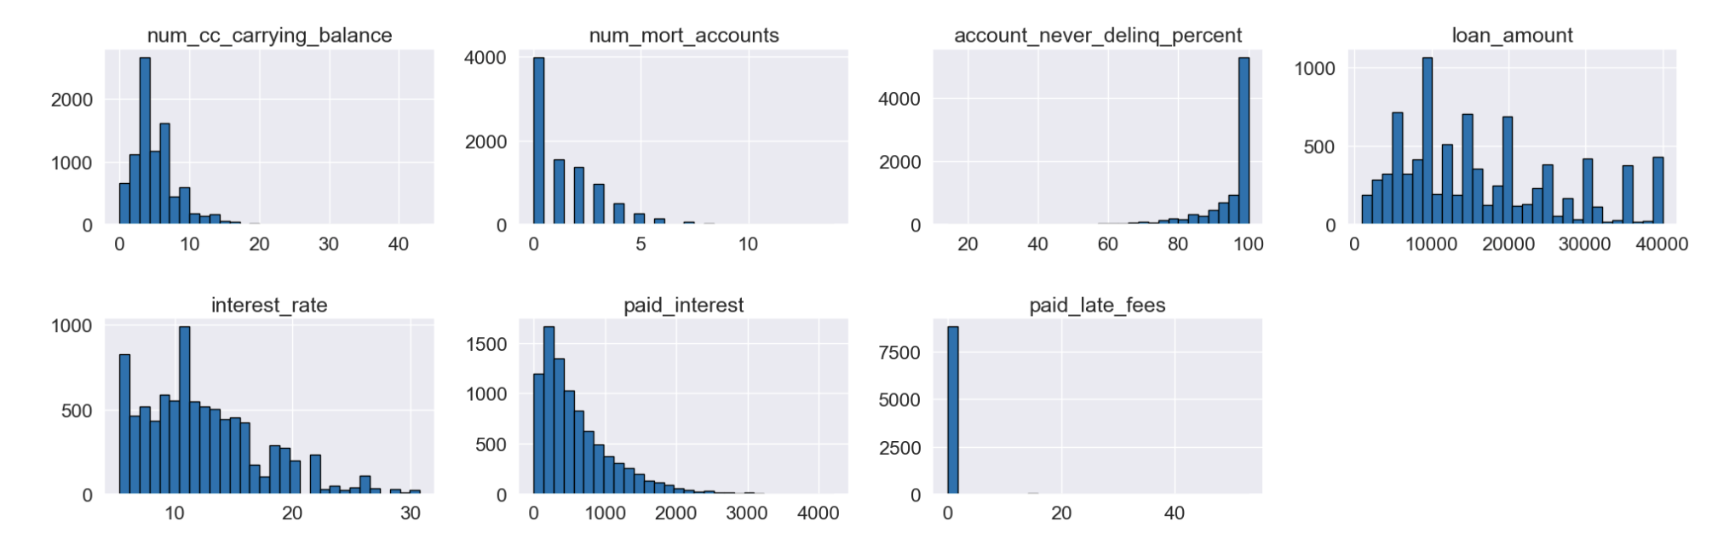

Slide 13
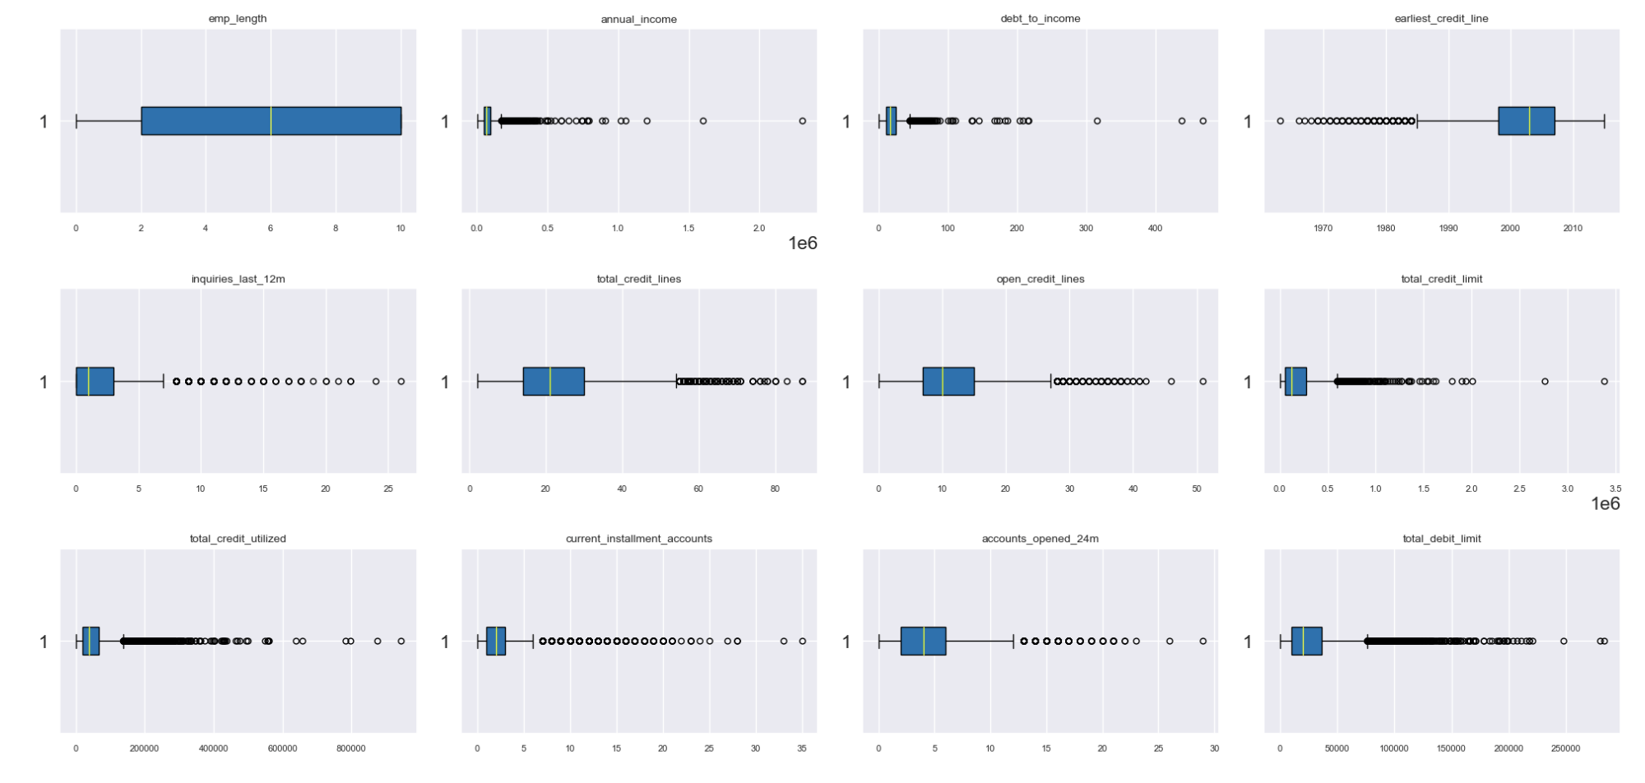
Boxplot:

Slide 14
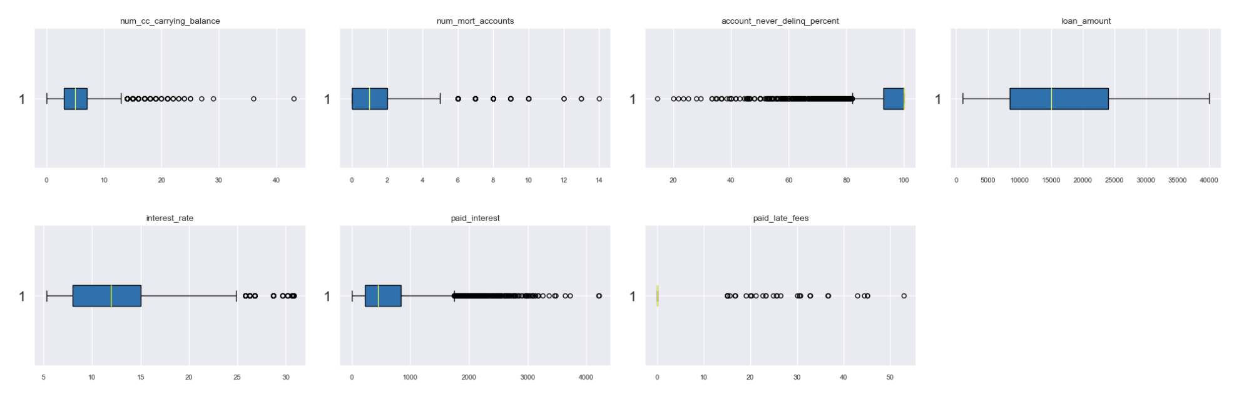

Slide 15
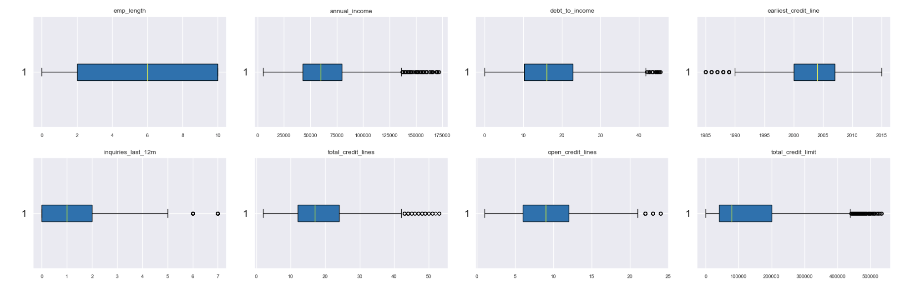
Same process will be repeated after removing the outliers:

Slide 16
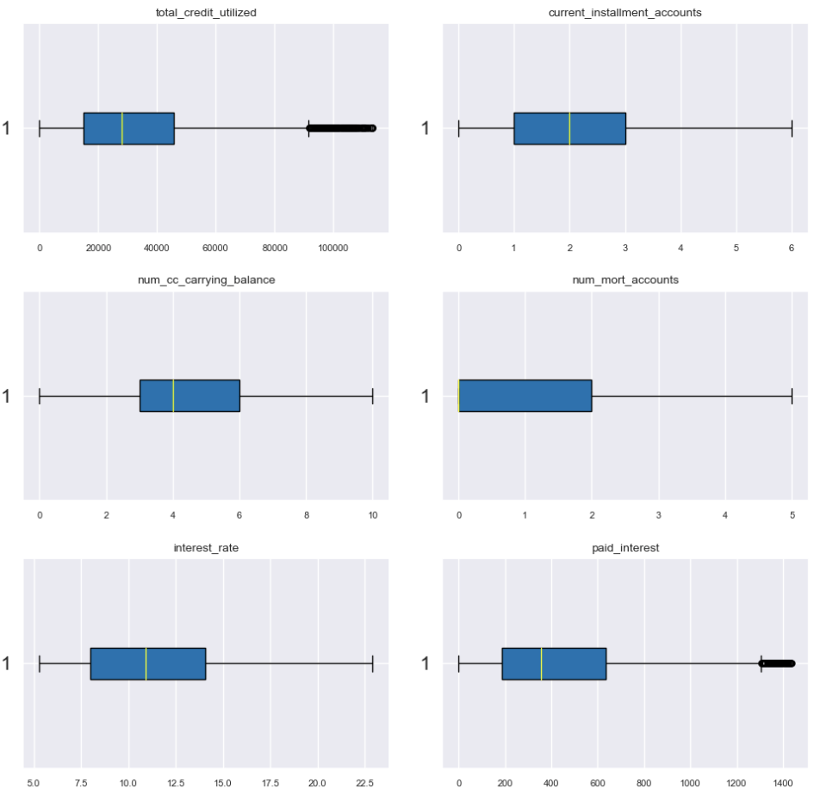
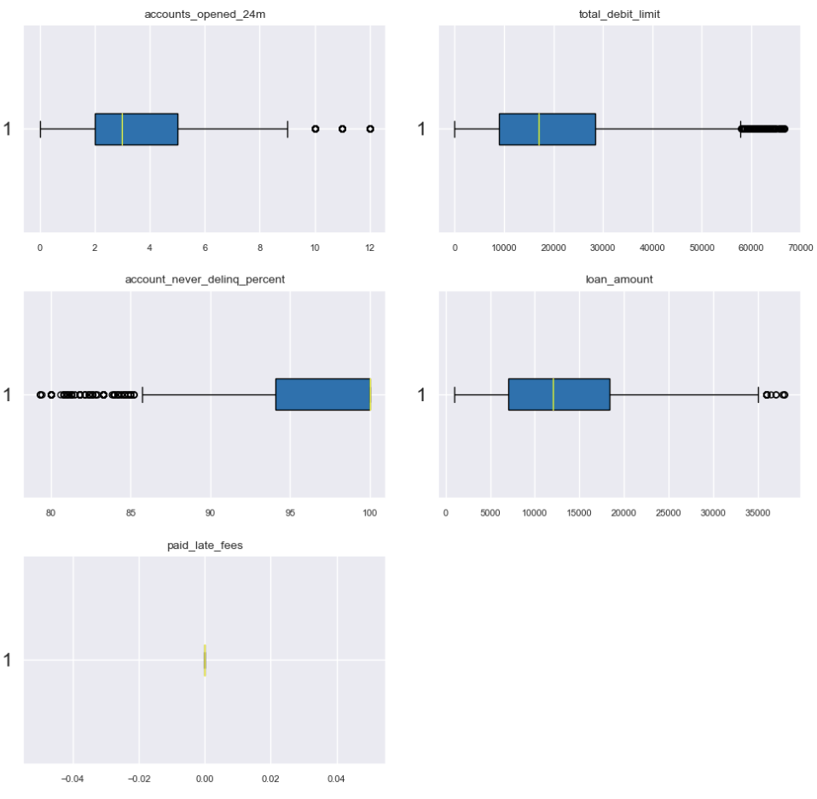

Slide 17
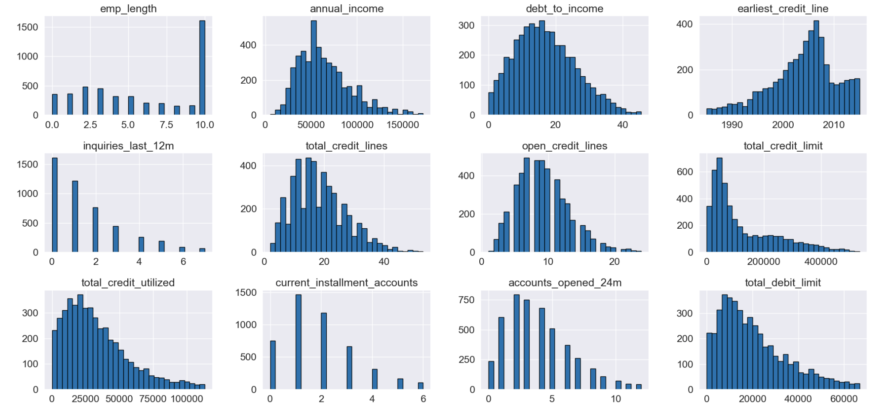

Slide 18
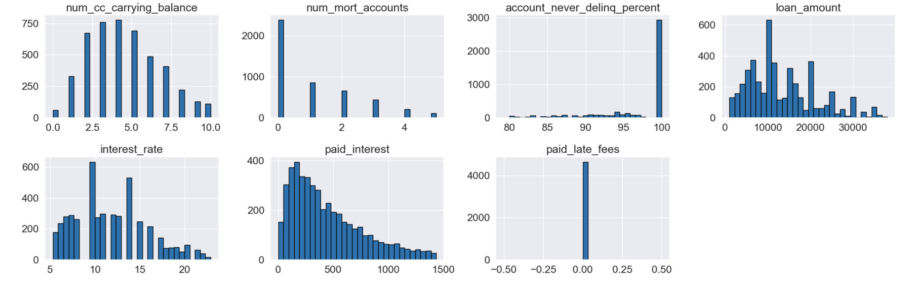

Slide 19
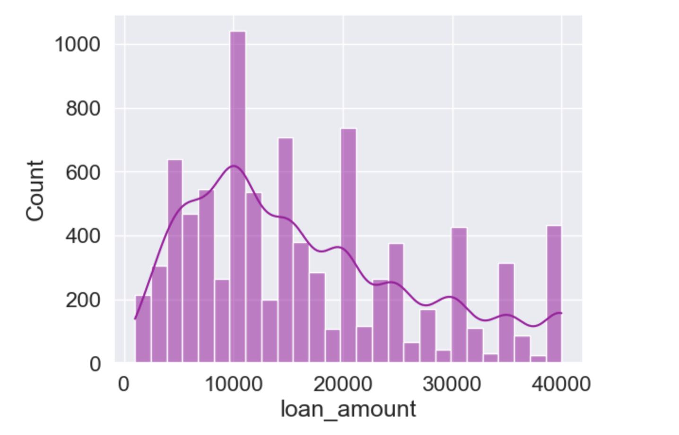
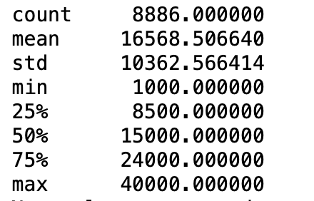
This plot is used to visualize the distribution of loan_amount within the loan_data dataset. The histogram shows the frequency of loan amounts in different bins. This can help in understanding the central tendency, spread, and shape of the loan amount distribution.

Slide 20
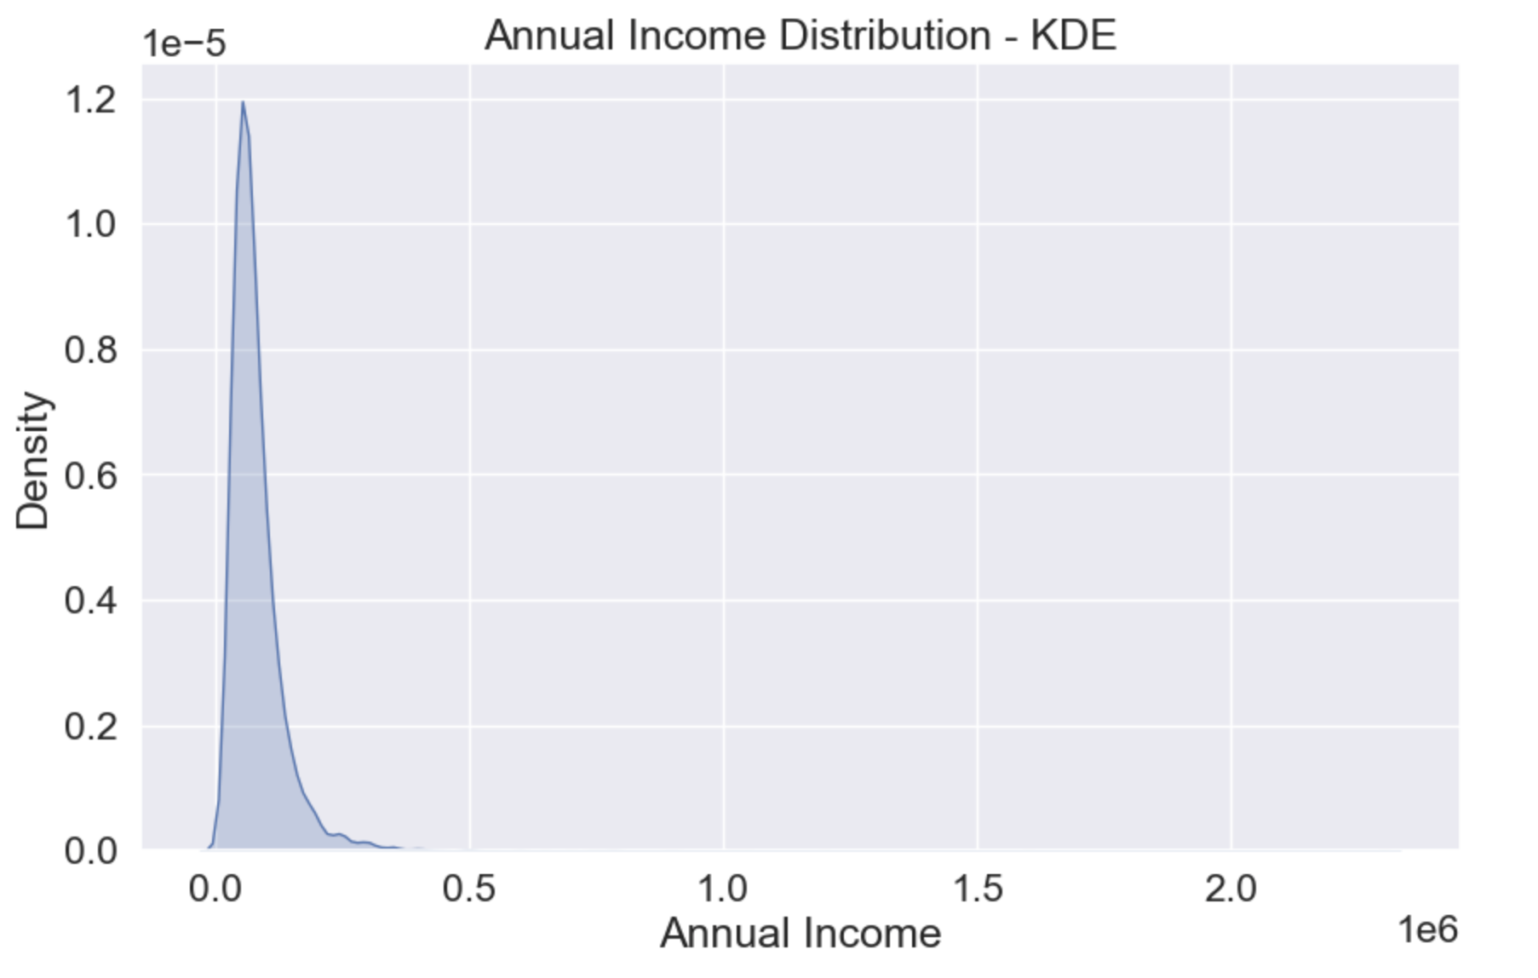
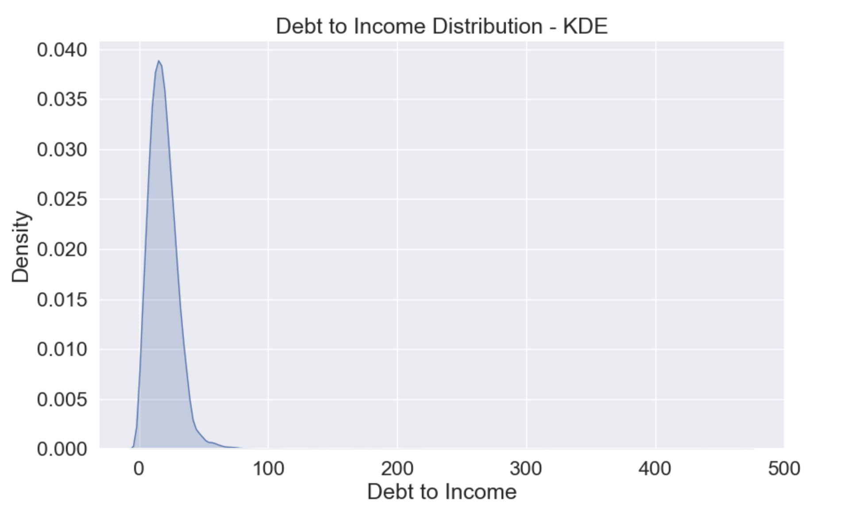
KDE plots:

Slide 21
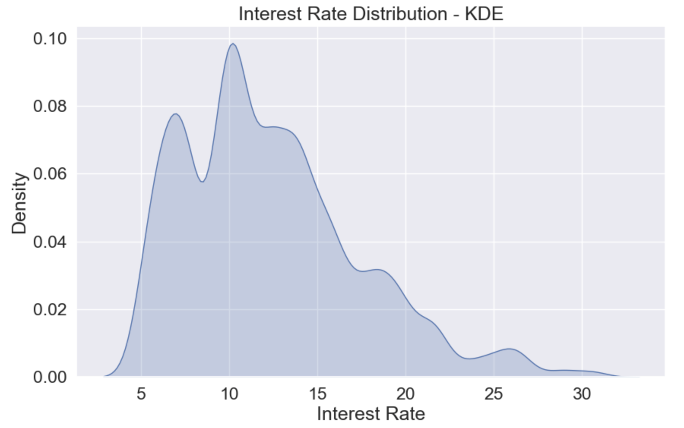
The interest_rate column has a lot of different values , this is why the KDE plot for it has this shape. And can not be very useful for us.

Slide 22
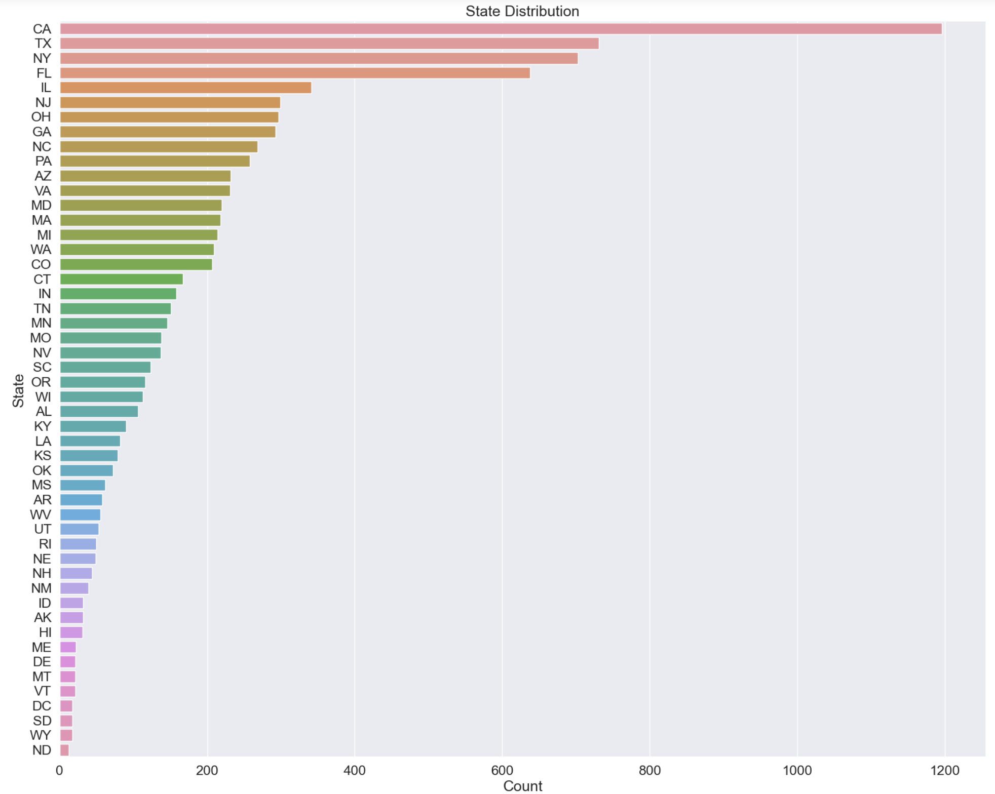
Frequency Counts:

Slide 23
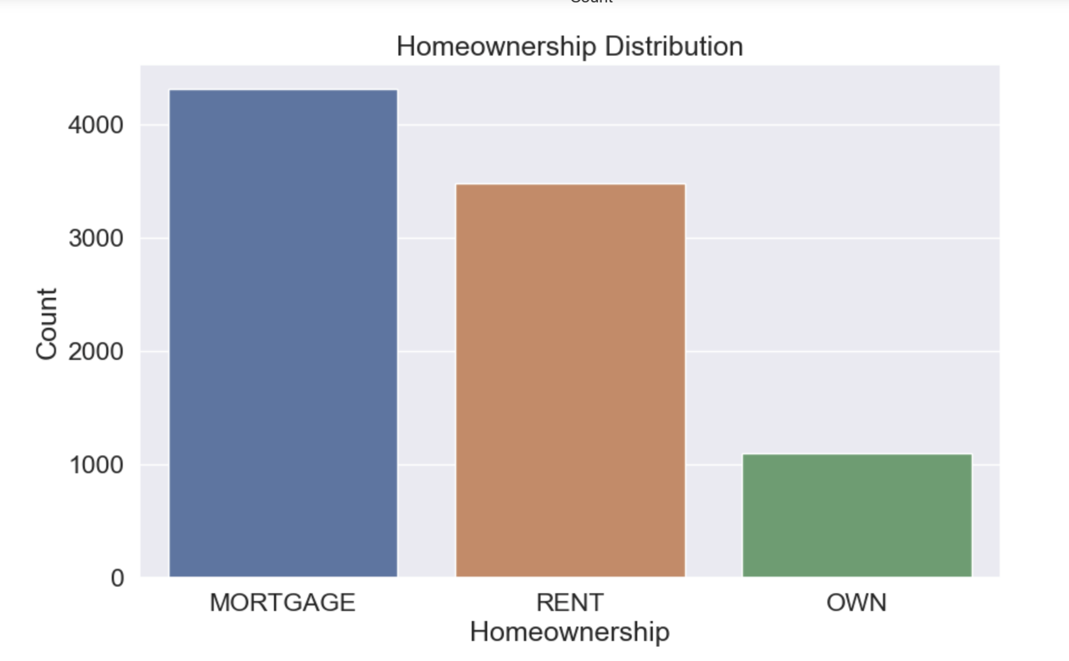

Slide 24
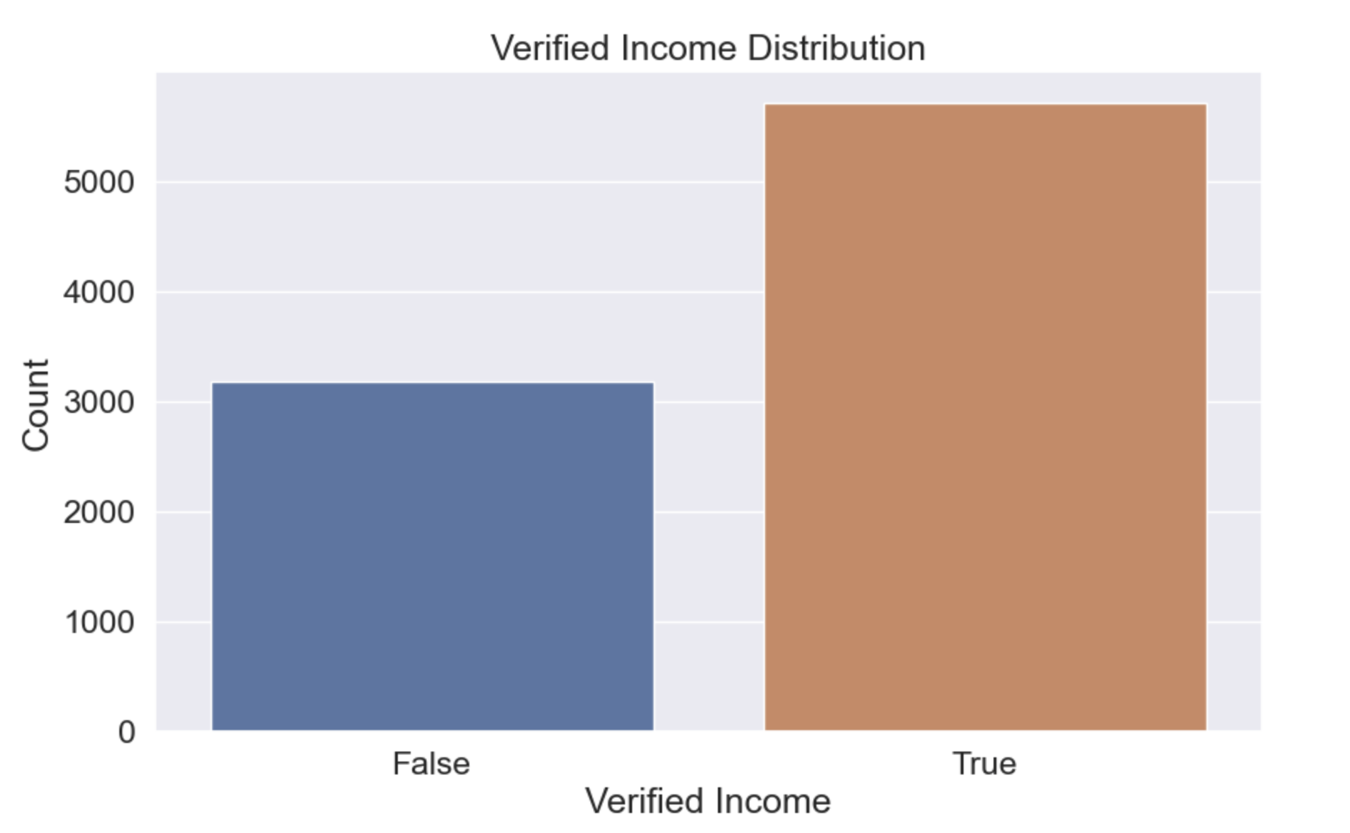

Slide 25
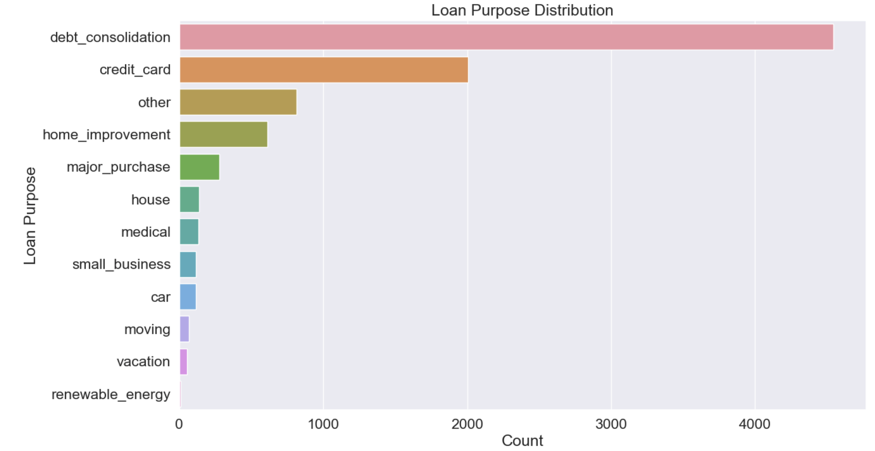

Slide 26
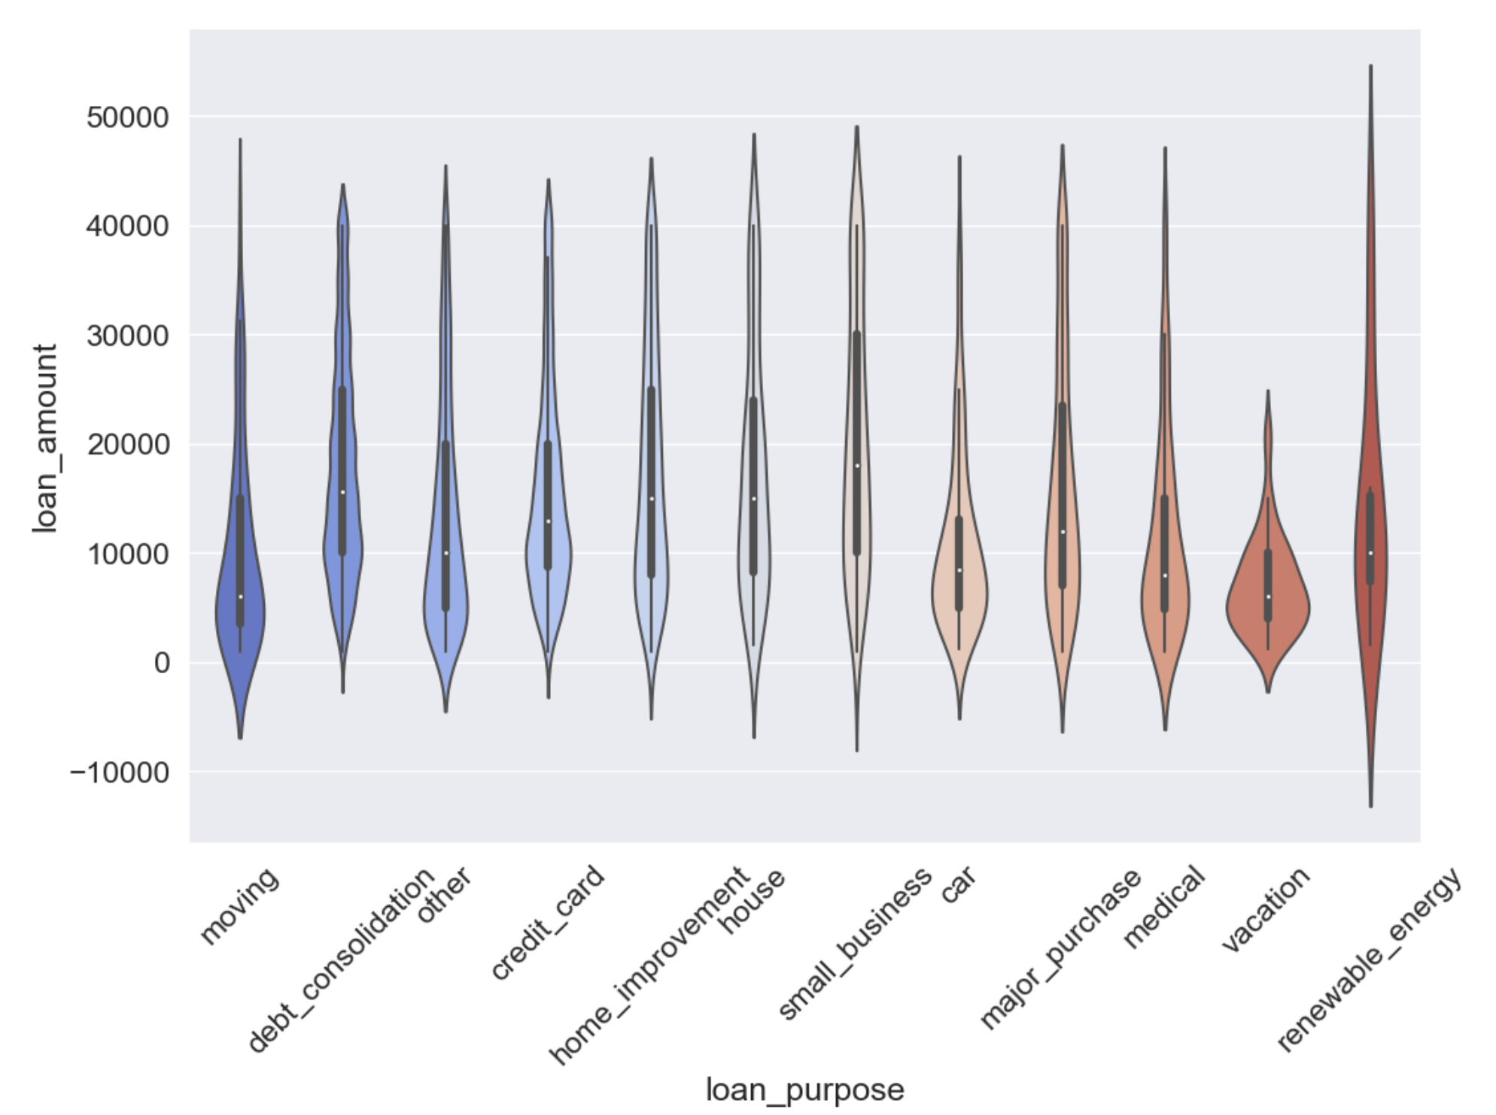
violin plot, which combines aspects of a box plot and a KDE plot. It shows the distribution of the data across different categories.
The width of the shape at different y-values indicates the density of data points at that loan amount.
This plot is particularly useful for comparing the distributions of loan amounts across different purposes and identifying any patterns or anomalies in the data.

Slide 27
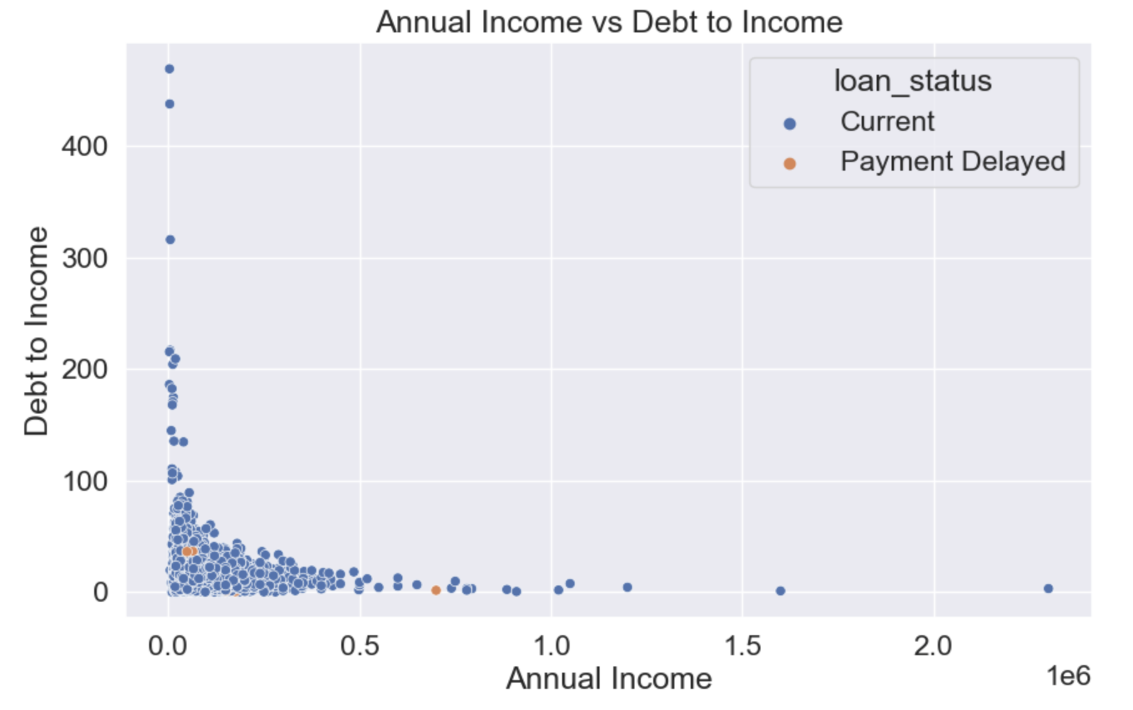
Scatter plot:
This plot helps in understanding how debt_to_income ratios vary with annual_income and whether there are noticeable differences based on loan_status.

Slide 28
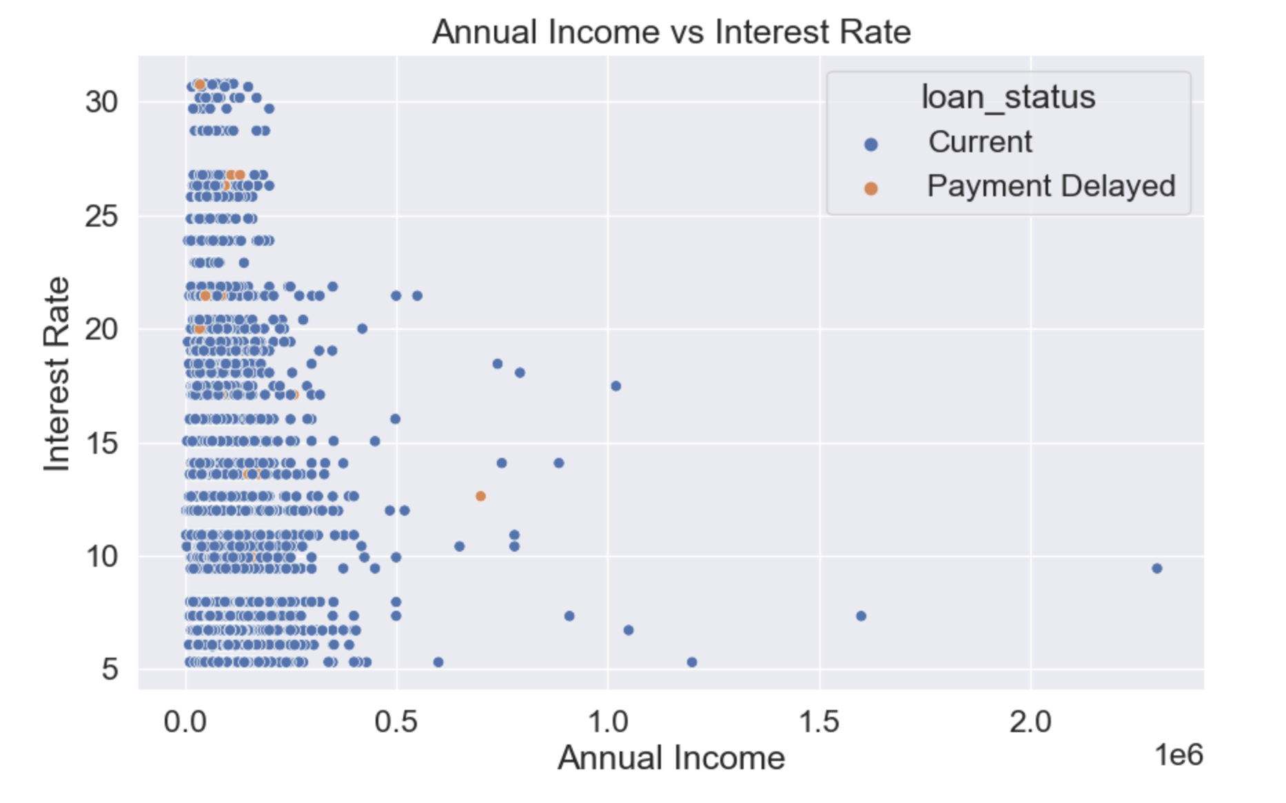
This plot can show if there is a trend where higher or lower annual incomes correspond to different interest rates and how loan status affects this relationship.

Slide 29
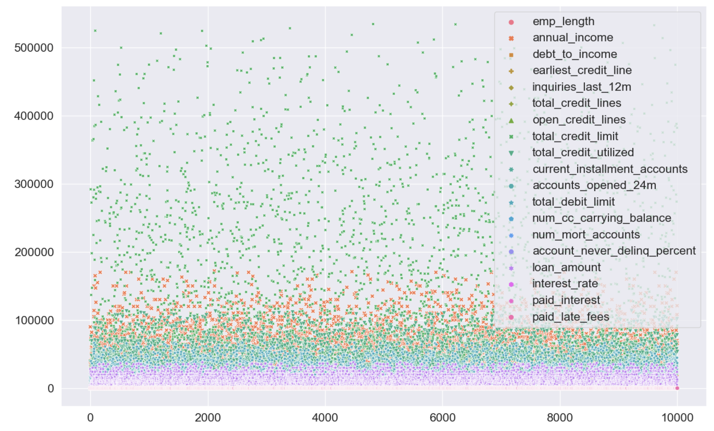

Slide 30
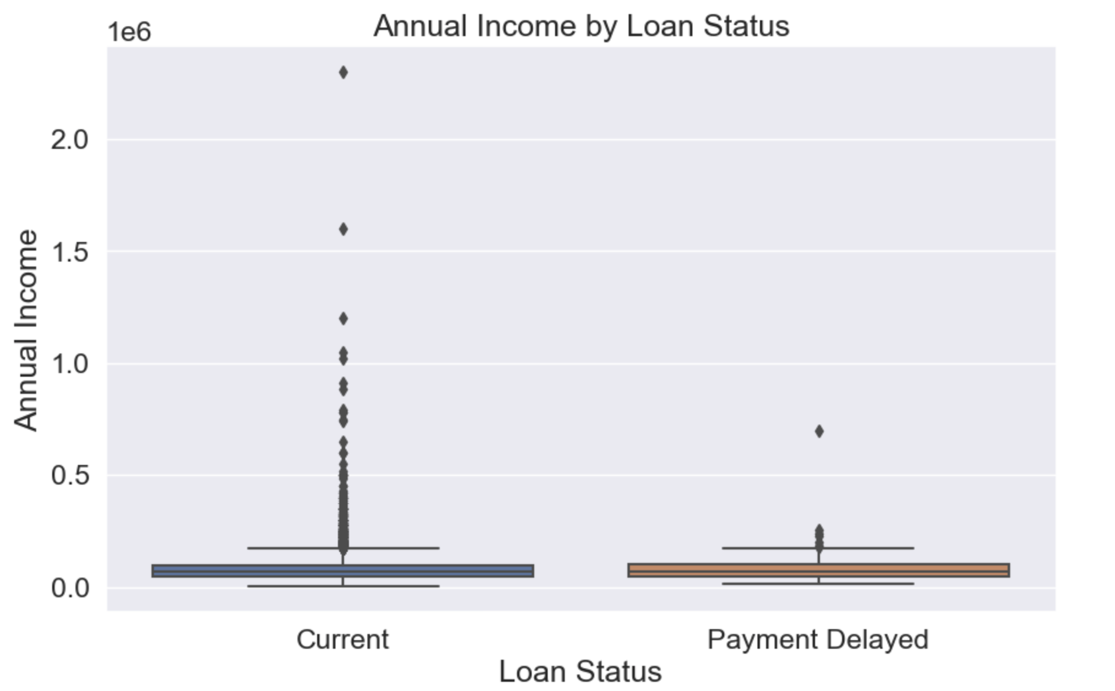
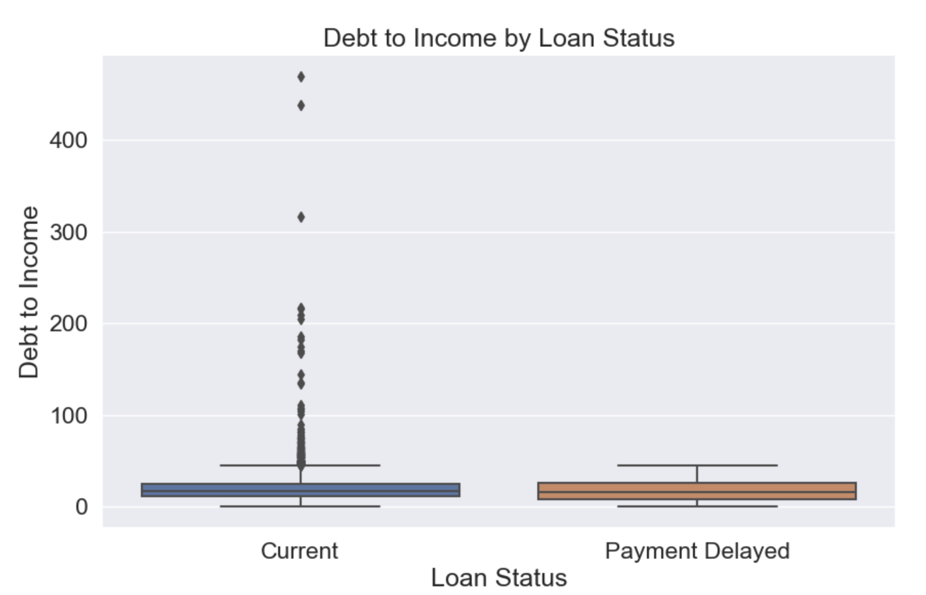
Box Plots by Loan Status:

Slide 31
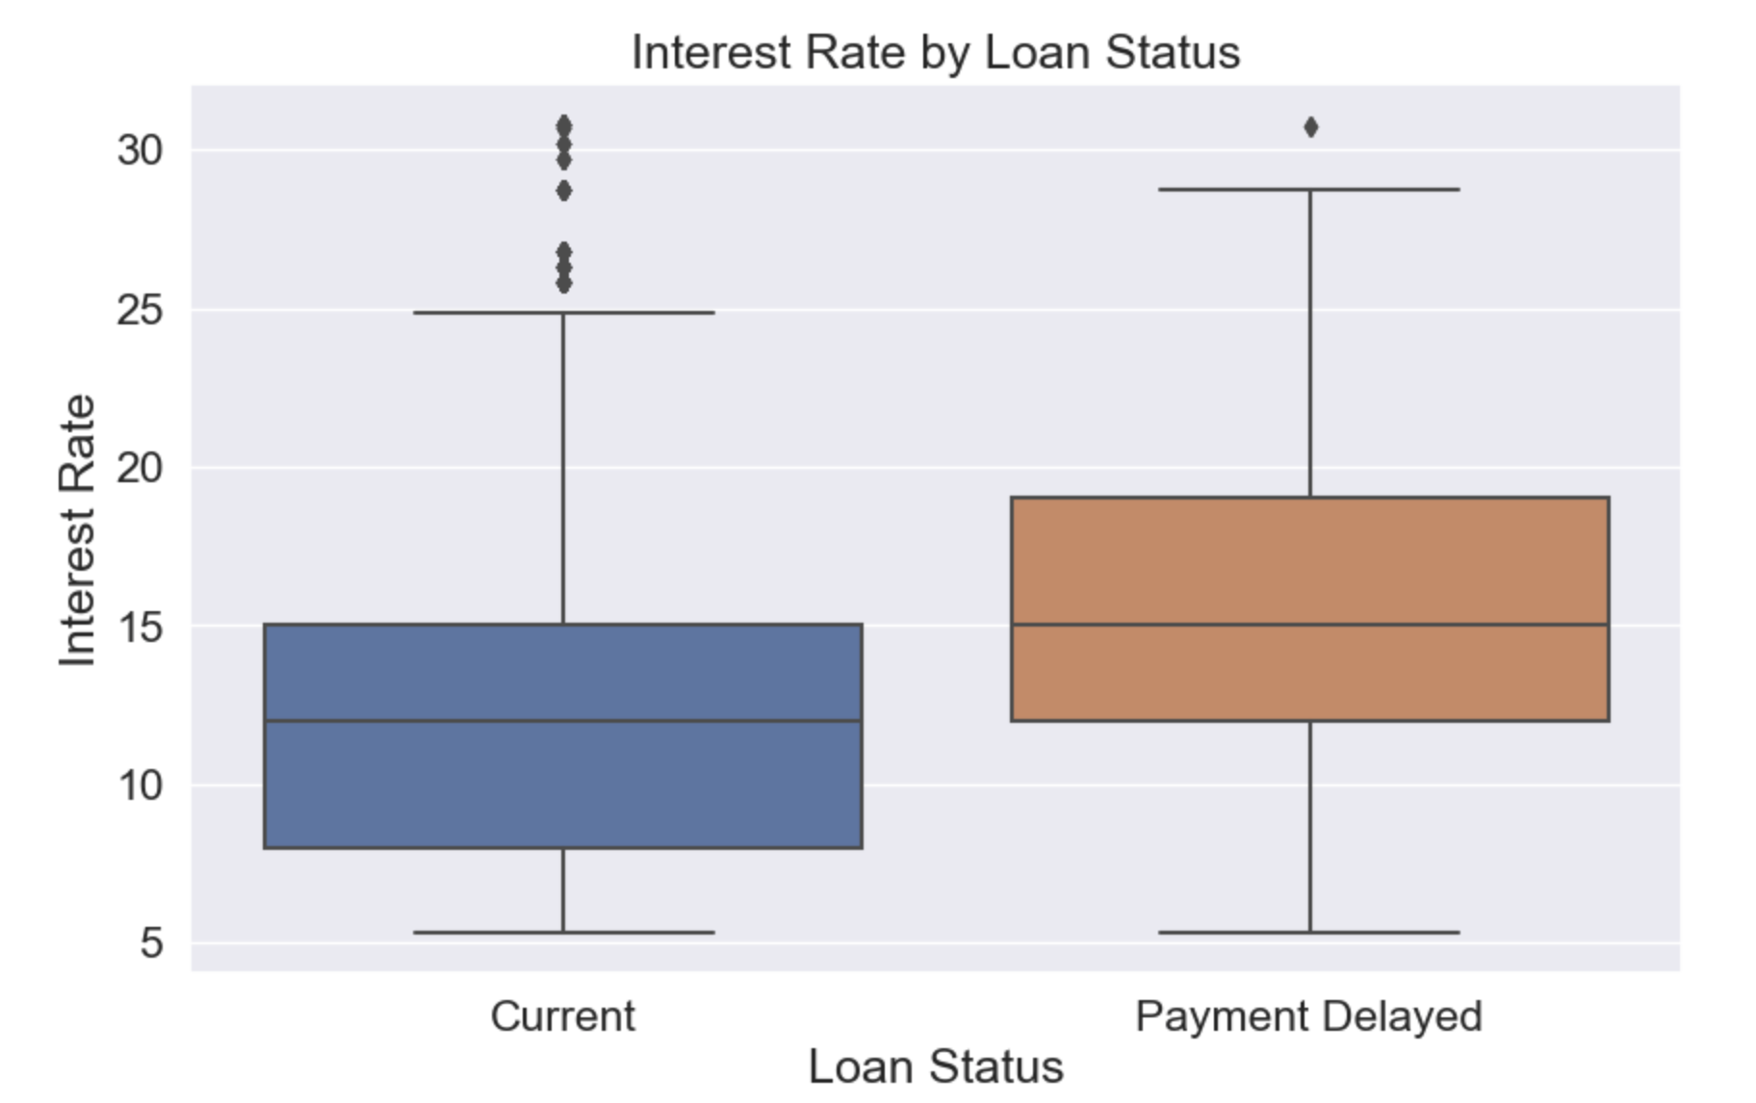
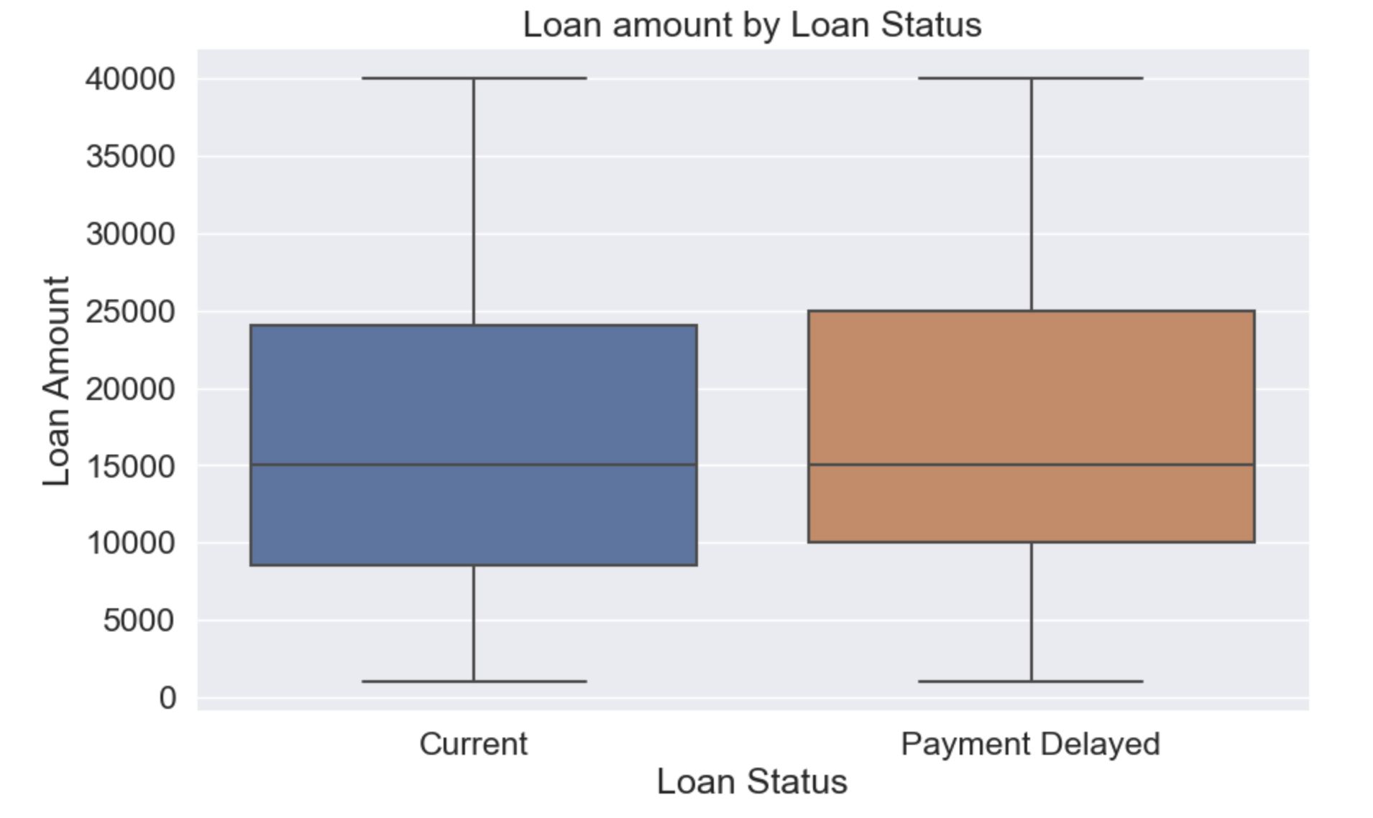

Slide 32
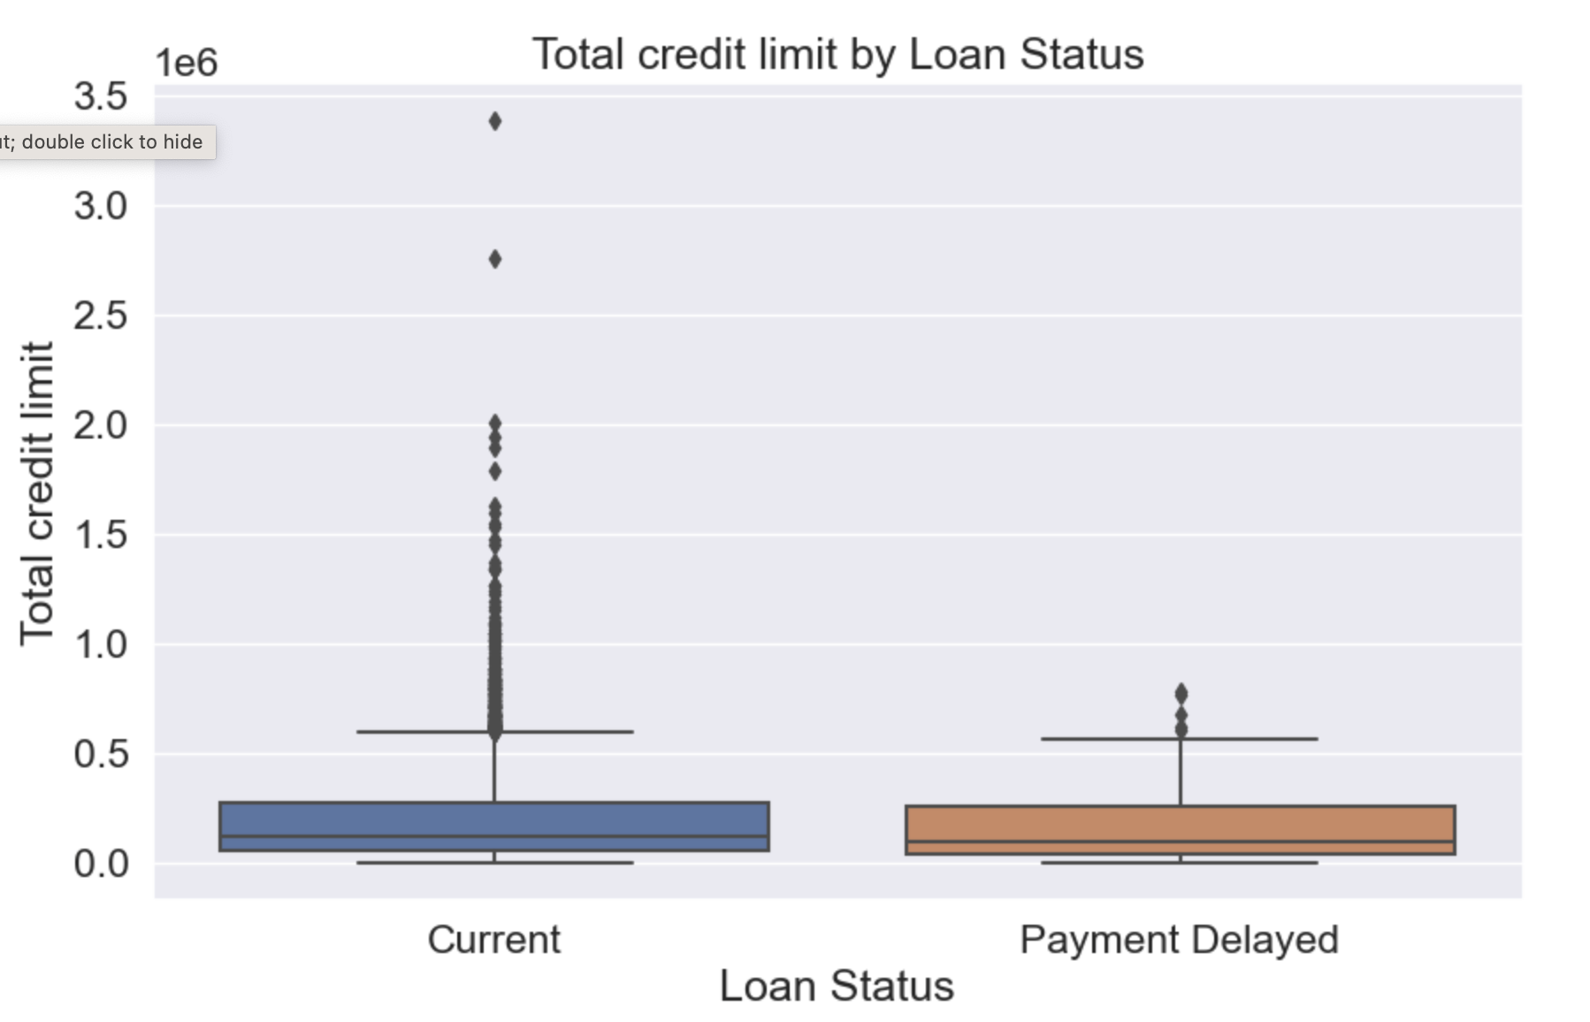
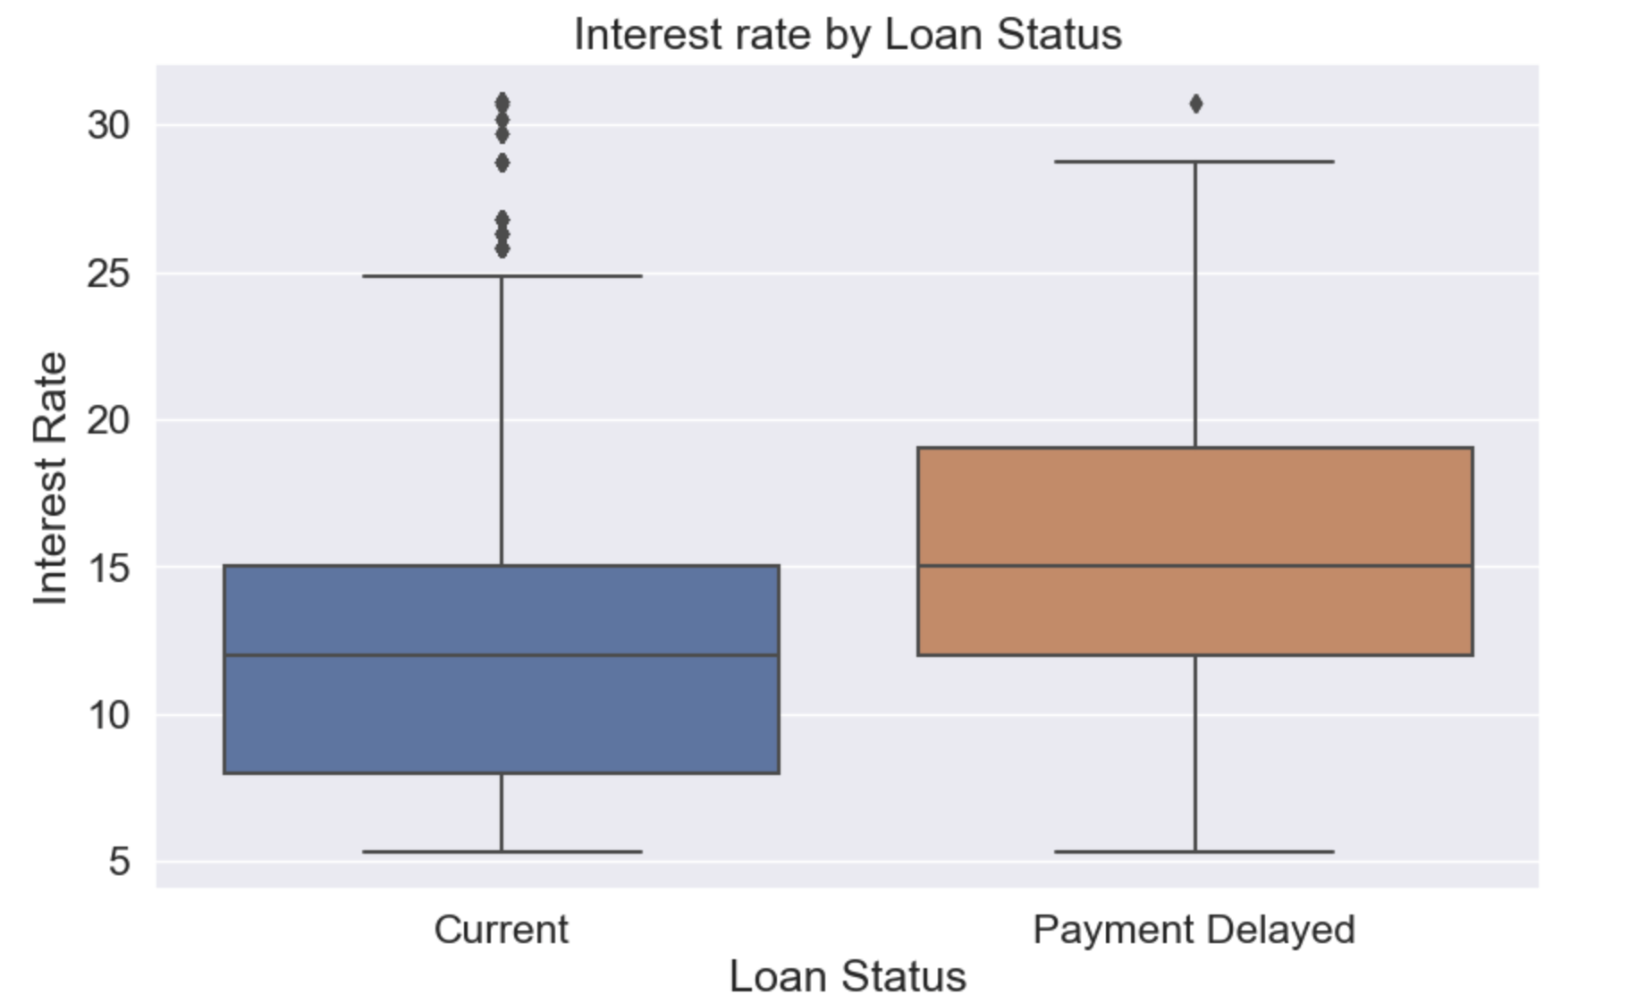

Slide 33
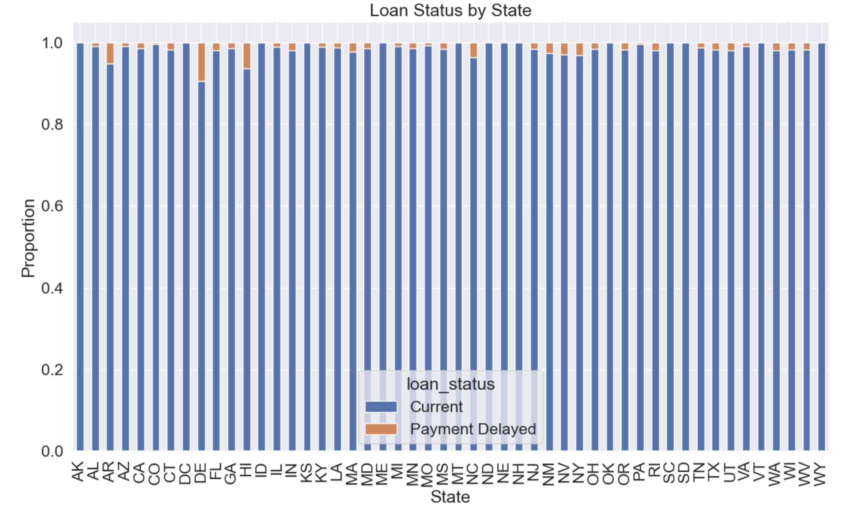
The cross-tabulation aggregates the data to show the proportion of each loan status within each state.
Each bar represents a state, and the different segments of the bar represent the proportion of different loan statuses within that state.
This type of plot is useful for comparing the distribution of loan statuses across different states. The stacked bars provide a clear visual comparison of how loan statuses vary from one state to another.

Slide 34
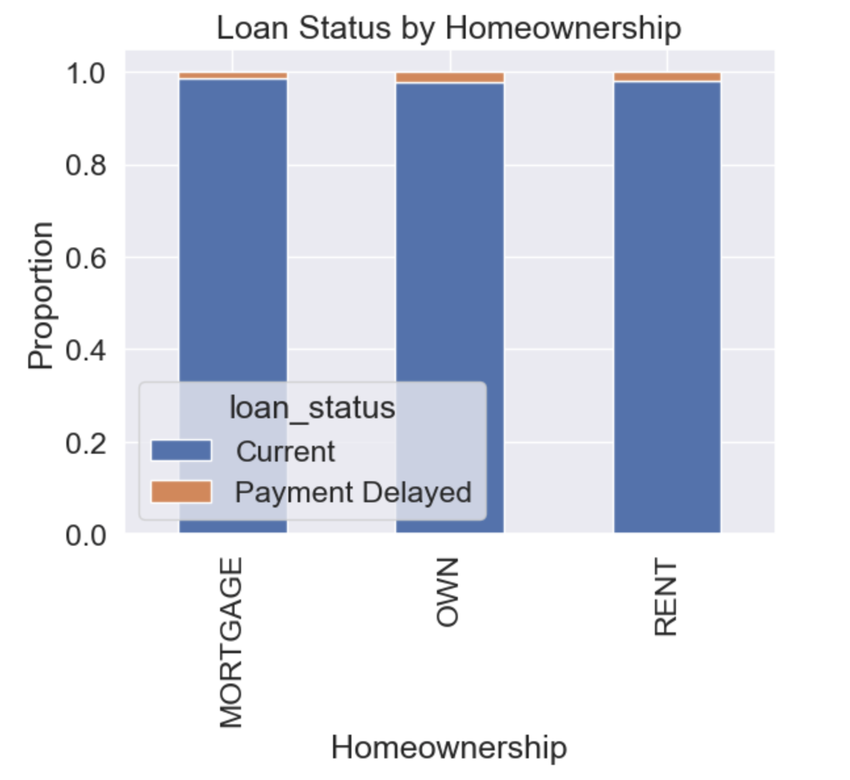
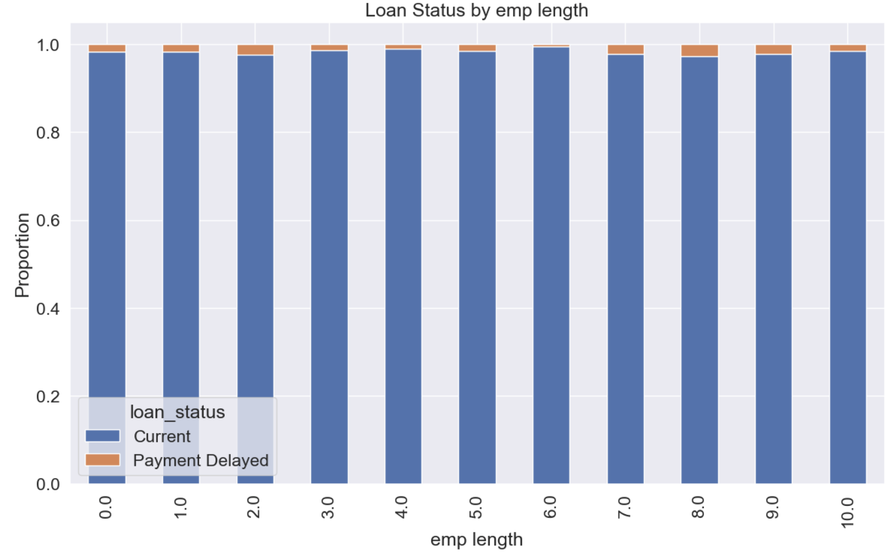

Slide 35
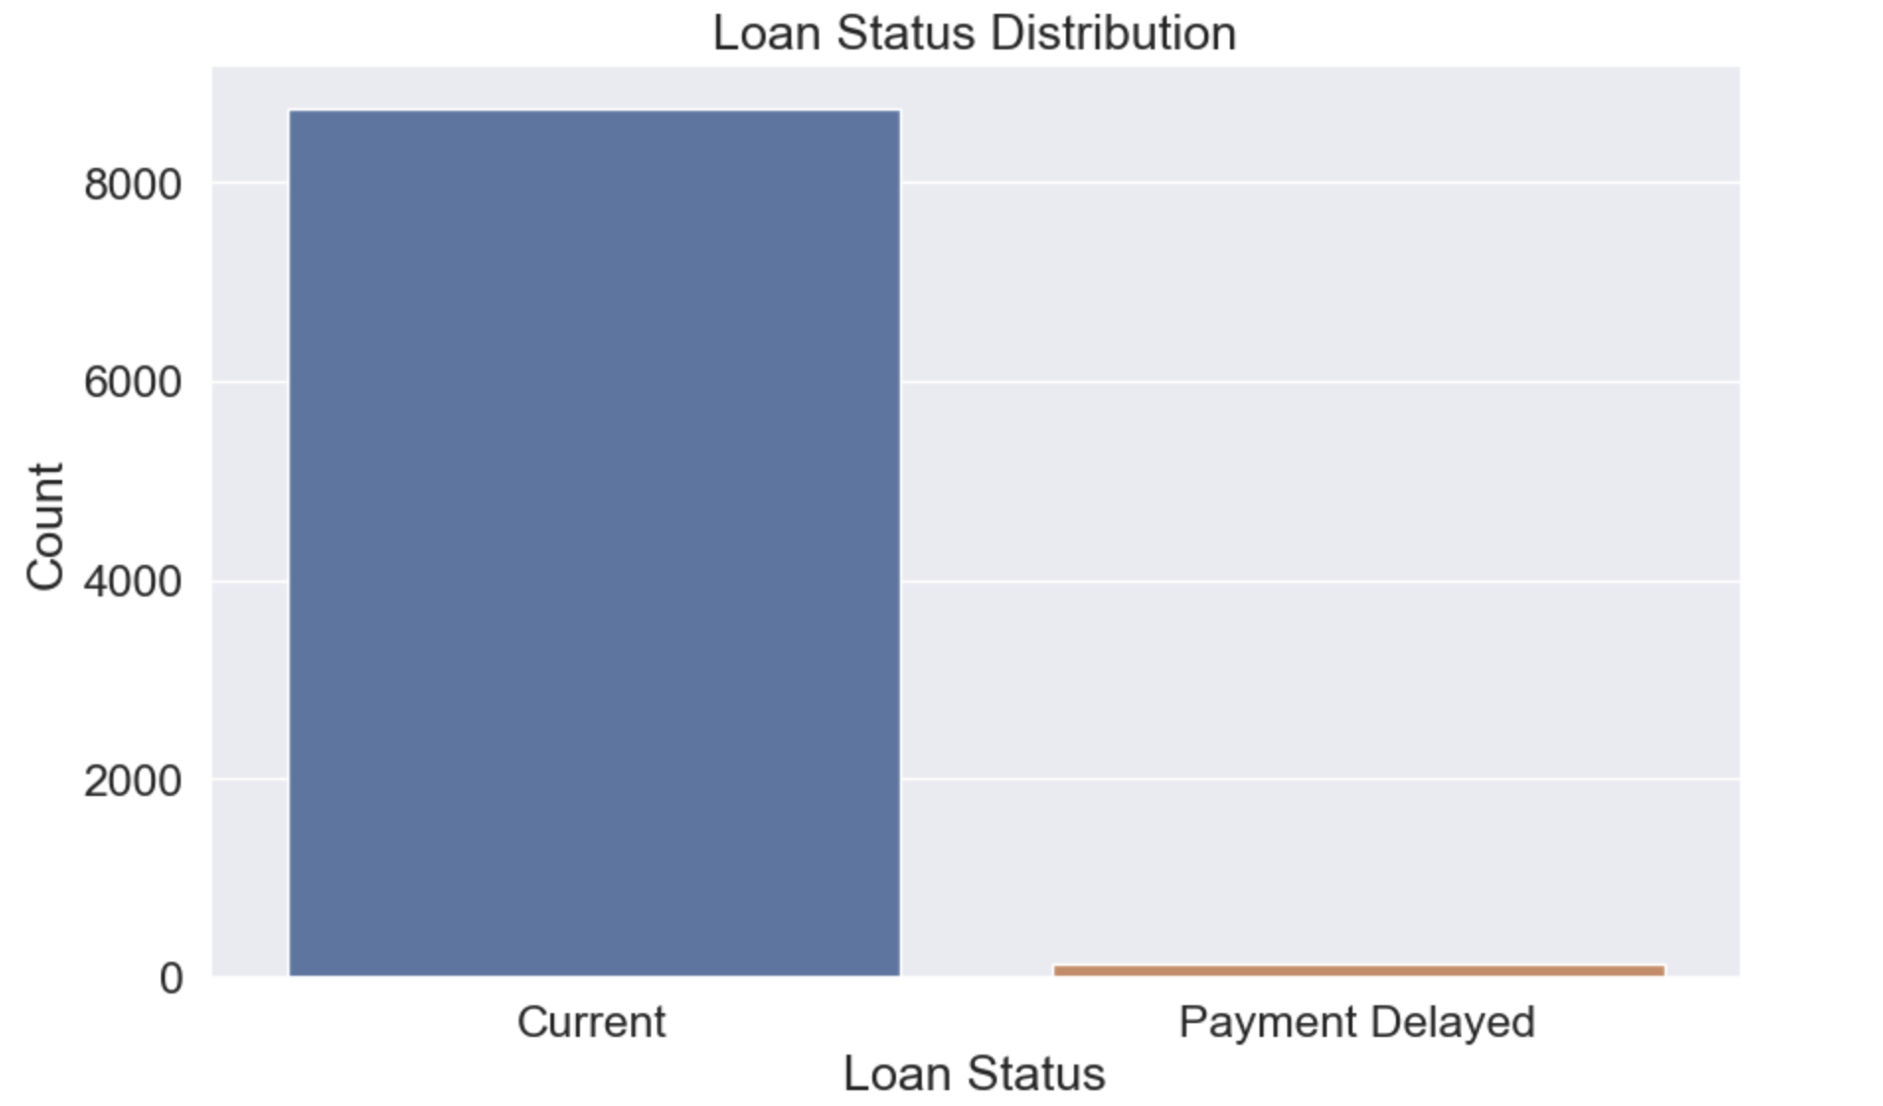
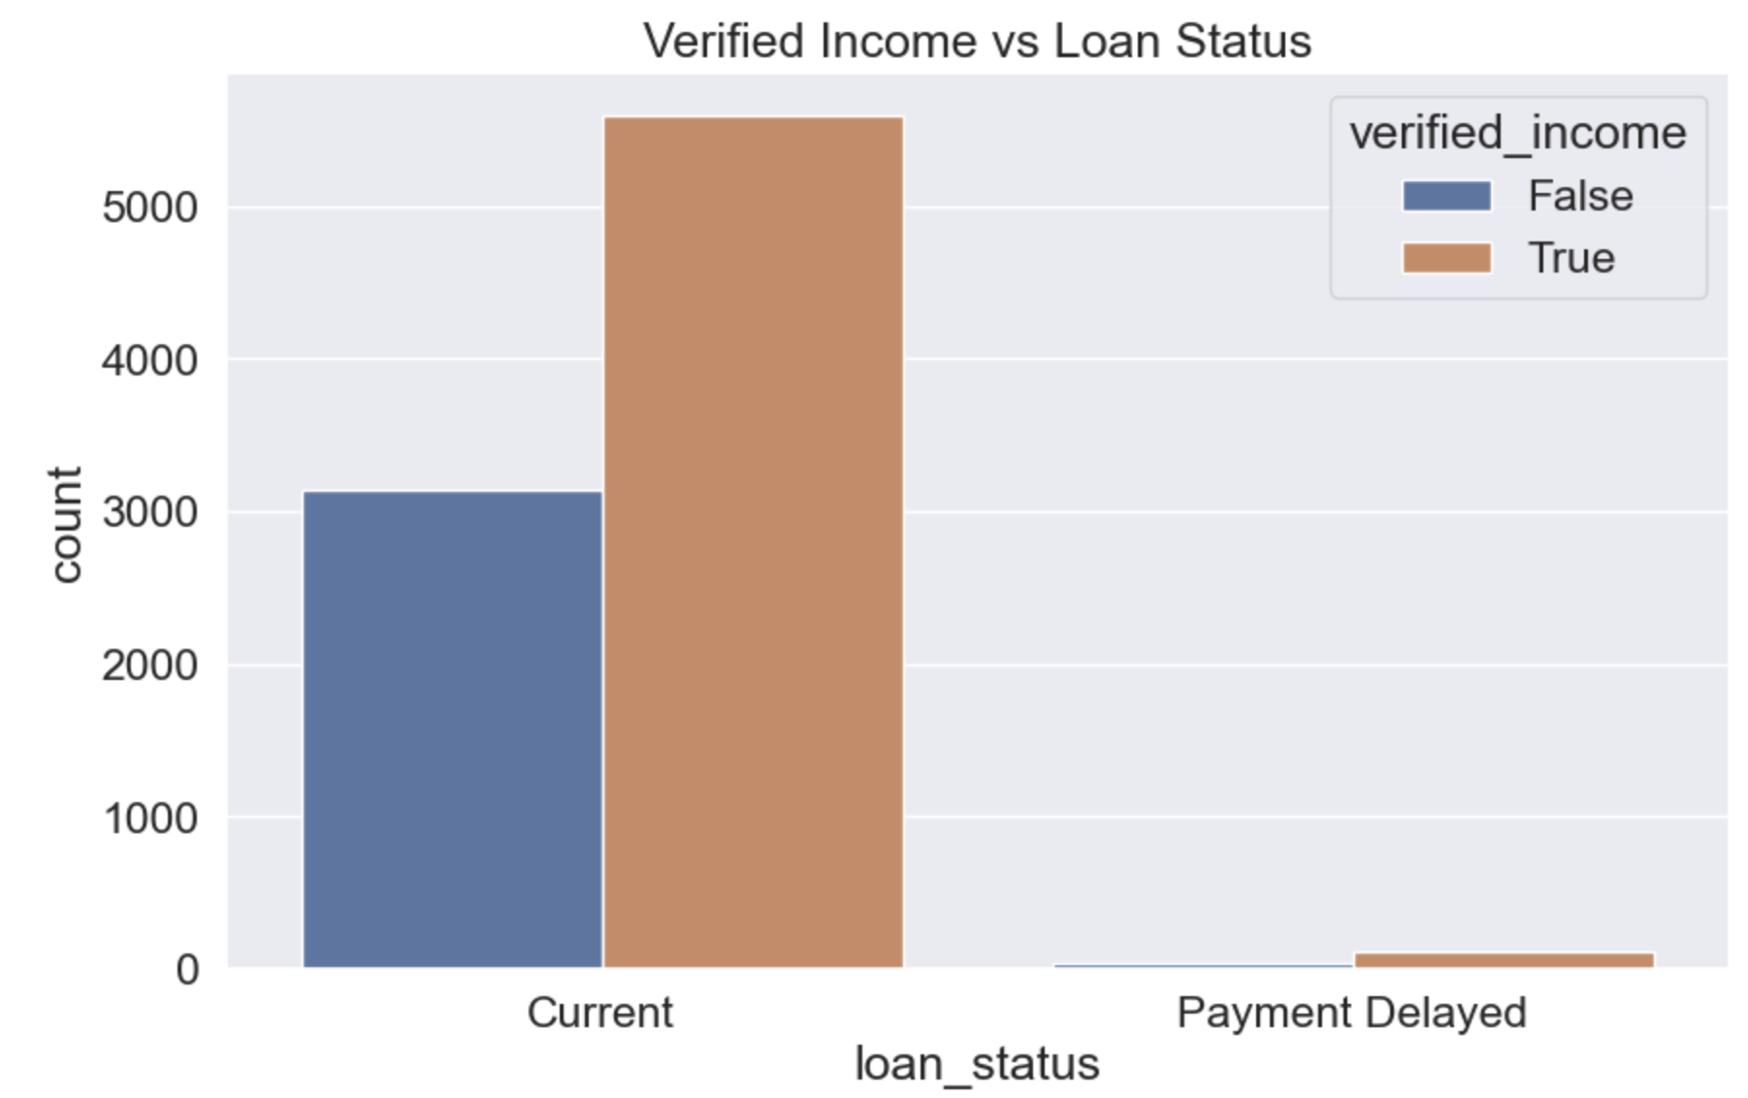
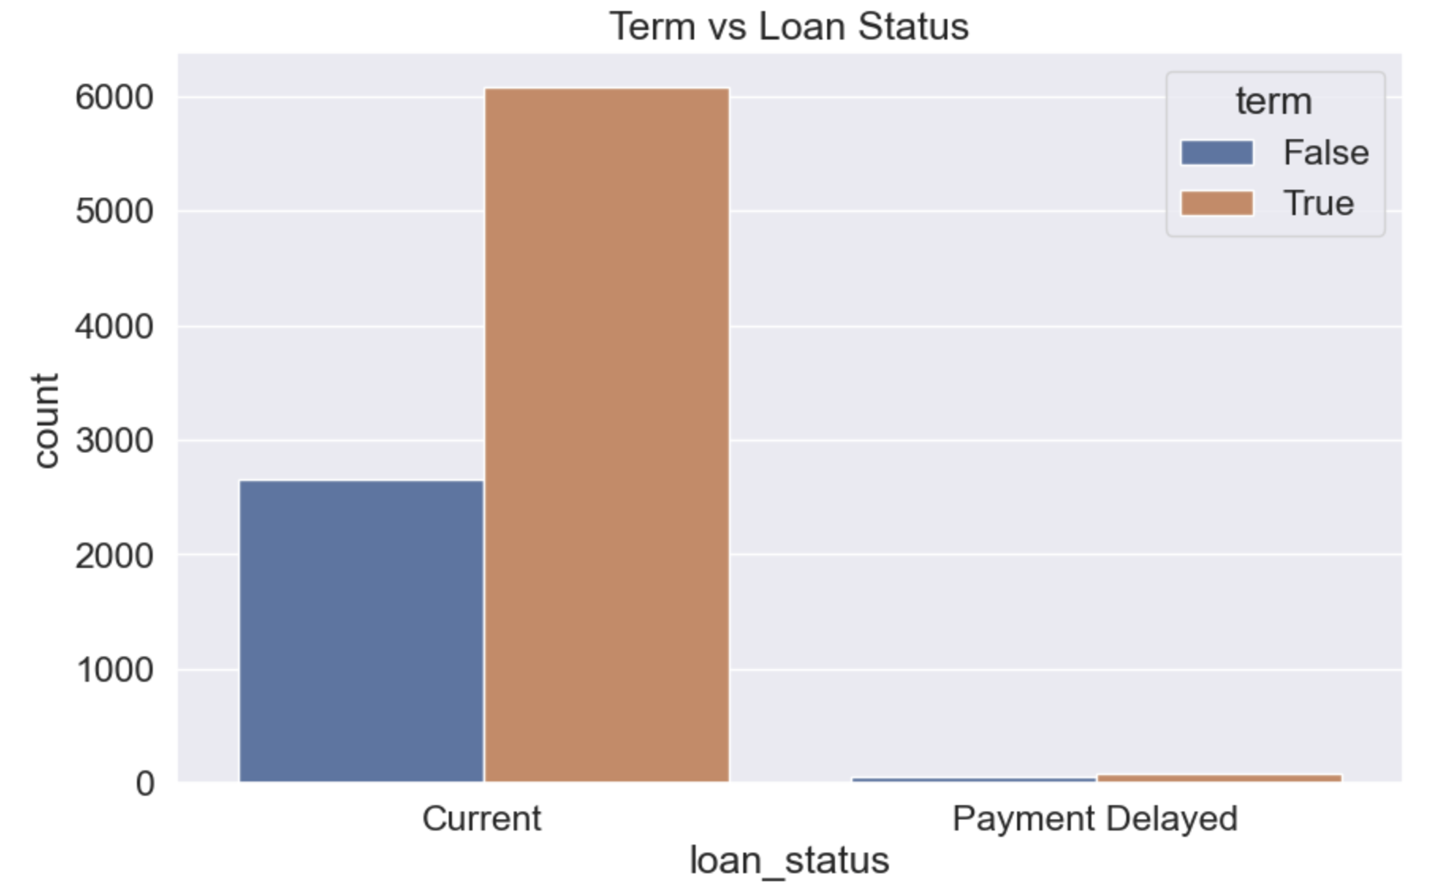
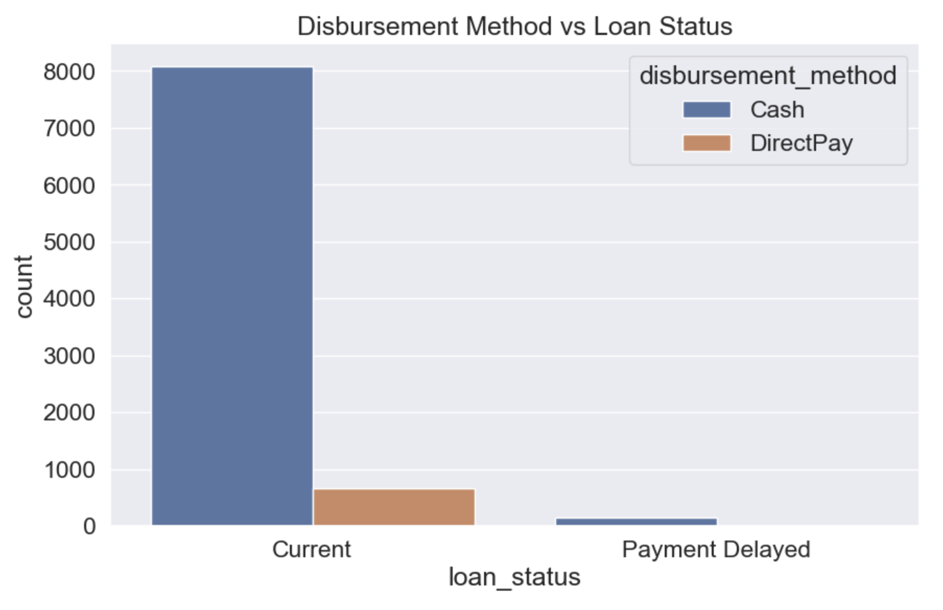

Slide 36
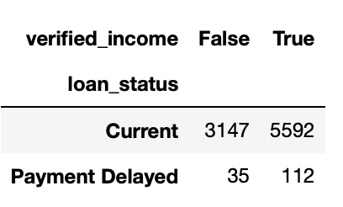
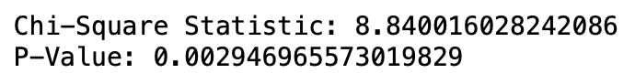
Stat test:
We will do a statistic test for the target column ‘loan_status’.
Since the p-value is less than 0.05, we reject the null hypothesis and conclude that there is a statistically significant association between loan status and verified income. This means the loan status distribution varies significantly depending on whether the income is verified or not.

